Slide 1
NOMNC = Notice of Medicare Non coverage
Termination of Care
If patient discharged from Medicare services and no other care will occur due to:
Not medically necessary/custodial/goals met
Patient not Homebound
SN not intermittent
Example of termination due to physician or provider orders: POC lists wound care twice a week, provider writes order to discontinue wound care.
Example of termination due to home health agency: The POC orders are PT 4xw, home health agency has lost PT staff and can no longer staff PT services
If a termination involves ending all of Medicare covered care, and no further care is being delivered, the only noticed issued would be the Notice of Medicare Non coverage (NOMNC).

Slide 2
NOMNC = Notice of Medicare Non Coverage
The NOMNC must be delivered at least two calendar days before Medicare covered services end or the second to last day of service if care is not being provided daily.
Note: The two day advance requirement is not a 48 hour requirement.
A NOMNC must be delivered even if the beneficiary agrees with the termination of services. Medicare providers are responsible for the delivery of the NOMNC.
The provider must ensure that the beneficiary or representative signs and dates the NOMNC to demonstrate that the beneficiary or representative received the notice and understands that the termination decision can be disputed. Use of assistive devices may be used to obtain a signature.

Slide 3
NOMNC = Notice of Medicare Non Coverage
Notice provided when all Medicare services are ending
For reasons such as no longer HB, goals met, no skilled services
Exception: Pt chooses discharge, DC for cause, no face to face completed
Allows patient to appeal discharge to QIO
QIO notifies HHA
NOTE: Includes all Medicare Plans (Traditional/FFS & Advantage Plans)

Slide 4
NOMNC = Notice of Medicare Non Coverage
Notice of Medicare Non Coverage – Generic form
Must be provided at LEAST two days prior to discharge date
Should not be a surprise
Can be given more than two days from anticipated discharge date
Allows patient to appeal the discharge
If patient gives you feedback that appeal likely, you want to start the detailed explanation of non coverage form.

Slide 5
When NOMNC is not Needed
When services are being reduced, not terminated- an HHCCN is used.
When a beneficiary transfers to another provider at the same level of care
When beneficiaries are moving to a higher level of care (e.g., home health care ends because a beneficiary is admitted to a SNF).
When beneficiaries end care on their own initiative (Document PATIENT CHOICE in DC Summary)
When a provider discontinues care for business reasons (HHCCN Option 2)

Slide 6
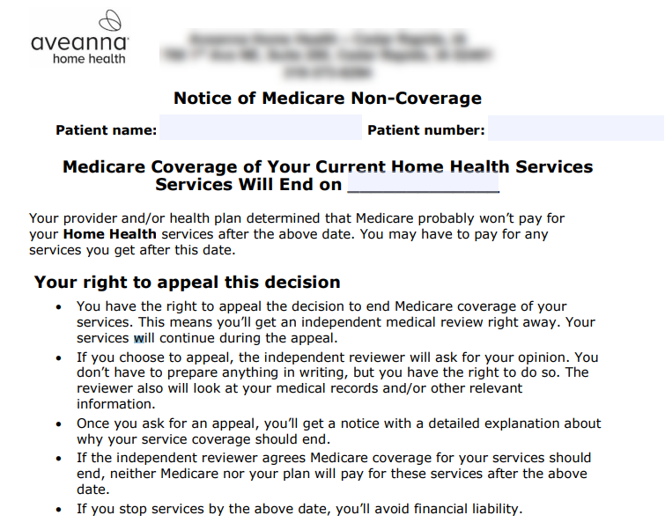
NOMNC = Notice of Medicare Non Coverage

