Slide 1
2025 HBA Member Leader Orientation
Welcome!
4 February 2025
Notes:
Welcome to the 2025 HBA Member Leader Orientation. Allow me to take a moments to say to those that are not new – thank you for your patience. We have been working to develop this training for a long time now. – Barb
Housekeeping: this session is being recorded. If you have questions during the presentation, please utilize the Q&A feature and we will do our best to answer all questions. If we aren’t able to answer all questions during the session, we’ll be sure to address them post-event. Tomorrow, you’ll receive an email with this presentation, recording and links to all the resources we’ll be mentioning

Slide 2
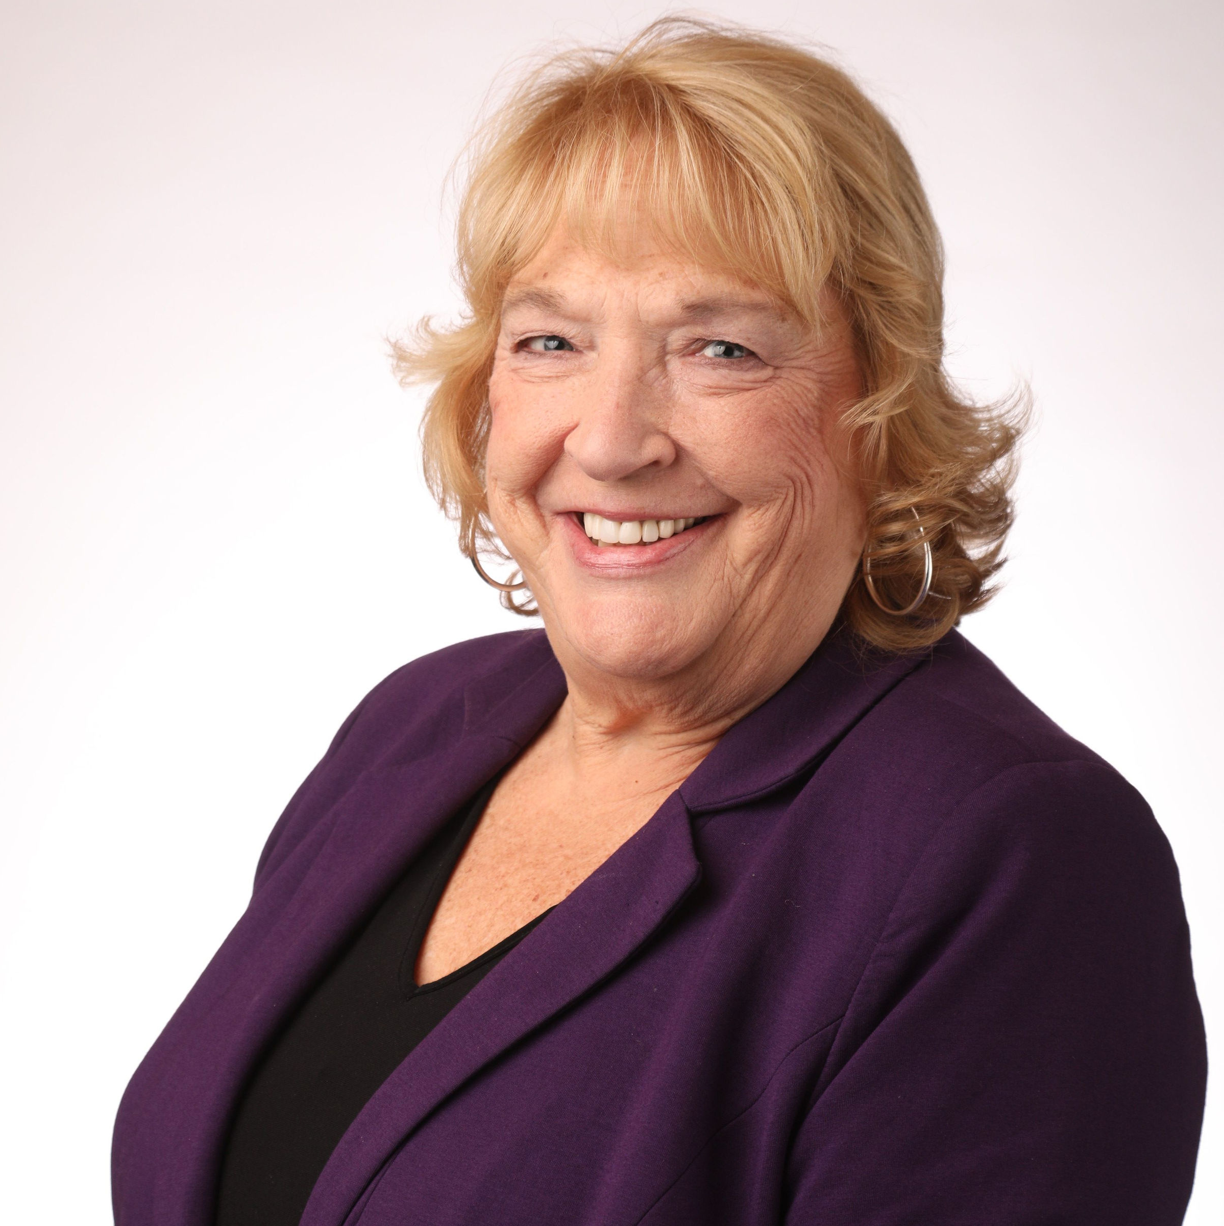
Barbara Bull
Senior Director
Member and Volunteer Experience
Notes:
Barb intro

Slide 3
Agenda
Welcome 2025 Member Leaders
Getting Your Bearings in 2025
2025 Annual Timeline and Important Dates
Member Leader Resources Update
Q & A
Closing
Notes:
Barb review agenda

Slide 4
Mission, Vision & Core Values
Mission Statement:
Further the Advancement and Impact of Women in the Business of Healthcare
Vision Statement:
Creating Women Leaders For Life
Core values
Visionary
Innovative
Inclusive
Notes:
Let’s start with our guiding principles. Our mission, our vision, and our values.
As you’ll see, we have updated them to better articulate where we want to go—our ideal future state—and how we are going to get there.
These aspirations are grounded in three core values: visionary, innovative, and inclusive. These values are more than words for us; they are the framework that inspires our culture, and drives our focus.

Slide 5
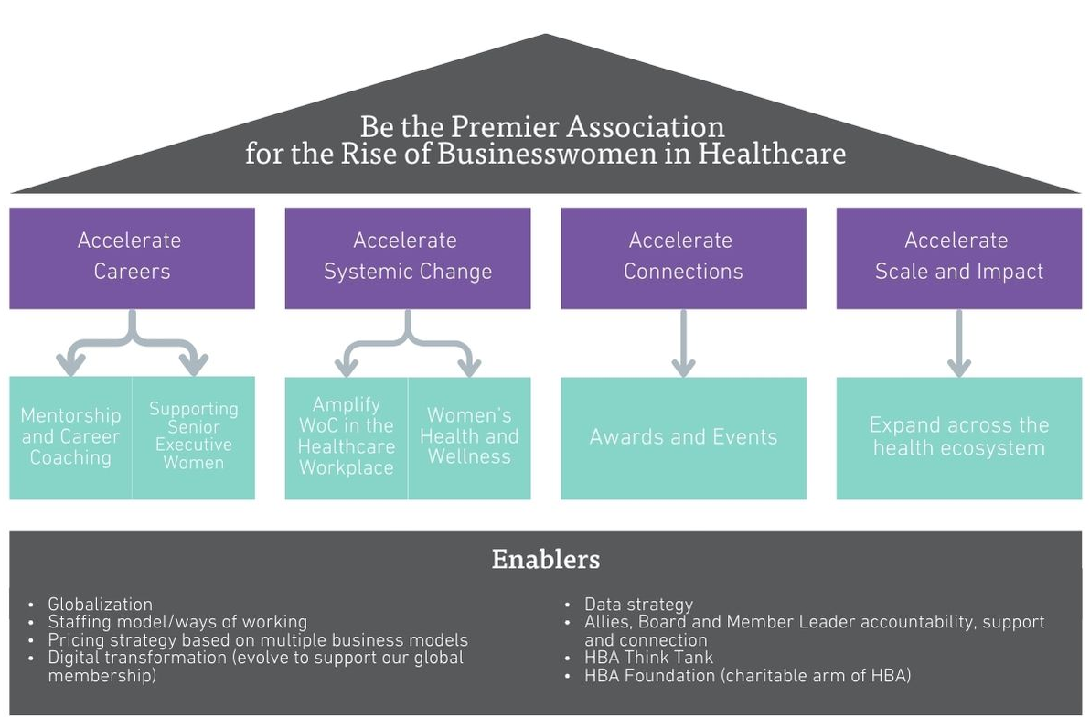
2025-2027 Strat Plan
Want to hear about the HBA’s new strategic plan in detail?
Visit the HBA Resource Center
Notes:
Visual Looking at our 2025-2027 strategic priorities, we’ve centered our work around four key pillars.
First, we’re focused on accelerating careers. Through leadership programs and career development initiatives, we’re preparing women to step confidently into roles that will shape the future of healthcare.
Next, we’re committed to propelling systemic change. We know that creating environments where women can thrive doesn’t happen by chance; it takes deliberate action. Our goal is to challenge norms and fast forward equity across the industry.
Third, we’re enhancing our commitment to accelerating connections. The HBA is considered an industry convener, bringing together a powerful network at events, both in person and virtual. Going forward, we’ll leverage the potential to do more, to offer more, to be there for you…more frequently and more meaningfully.
Finally, we are dedicated to scaling our impact. To truly drive change, we must extend HBA’s reach across the healthcare ecosystem, embracing new sectors and new global markets, and new locations in every corner of the globe.
In the green boxes, you’ll see a few specific initiatives that will bring these pillars to life.
A key focus for us is expanding global reach and leadership development. We’re ensuring women worldwide have access to essential resources and support. With a renewed commitment to inclusivity, we’re amplifying the voices of women of color and sharing diverse career journeys to inspire the next generation of leaders.
In terms of health and wellness, the HBA is taking action to support women holistically—not only with leadership skills but with health and wellness programs…like October’s World Mental Health Day celebration.
We’re partnering with key stakeholders and conducting research on how women’s health intersects with career advancement. Our HBA Think Tank will deliver greater value for companies, leveraging data to highlight what’s working and set new standards that challenge the status quo.
To highlight our members’ achievements, we’re reimagining our awards and events. Our signature events—the Woman of the Year Gala and our Annual Conference—are moving to new locations, making our events accessible to even more members. And we’re expanding our awards program on a global scale, leveraging opportunities to recognize extraordinary leaders, and companies accelerating impactful change and progress.
We’re also broadening our partnerships to connect with payers, providers, and leaders in digital health. These collaborations not only expand our network but amplify HBA’s influence.
Through increased visibility at high profile global events like Davos, the G20 Summit, and South by Southwest—to name just a few—we can be more effective at positioning HBA in the center of global conversations that impact women’s roles in healthcare.
I’m deeply inspired by the journey ahead for the HBA. With these bold initiatives, we’re igniting more than just a network—we’re leading a movement that empowers women in healthcare to rise to their fullest potential and redefine the future of this industry.
Over the coming weeks, our staff team will be hosting town hall webinars with our regional and chapter leaders to dive deeper into our 2025 Strategic Plan. I hope you’re as energized and excited about our collaborative future, as the Board has been in setting this course forward.
With our 2025 Board of Directors guiding the way, we’re ready to propel HBA’s momentum to new heights. I couldn’t be more confident in the strength and vision of our leadership team as we embrace this exciting next chapter together.

Slide 6

5-10 Year Strategic Plan Vision
Be the
Premier Association
For the Rise of Businesswomen in Healthcare

Slide 7
Creating
Women Leaders
for Life
Notes:
And ultimately ..

Slide 8
2025 Operating Plan

Slide 9
2025 HBA Operating Plan Highlights
Foundation and Research
HBA Foundation
Education and Recognition
HBA Academy
Global Growth and Mentorship
Senior executive support
Executive Leadership
Global expansion
Think Tank Expansion
Awards and events
Mentoring program
Career growth initiatives
Notes:
I am excited to share the 2025 Operating Plan for HBA, outlining our strategic priorities and key initiatives for the year ahead. Our focus remains on expanding our global impact, advancing women in healthcare, and strengthening our leadership in thought leadership and professional development.
We are thrilled to introduce the HBA Foundation, a new charitable arm of HBA dedicated to advancing data and research. The Foundation will focus on supporting students, fostering healthcare workforce development, and championing women of color. Through this initiative, we aim to drive meaningful change and create lasting impact in the industry.
Building on our commitment to data-driven insights, we will expand our Think Tank on a global scale. This initiative will:
Capture and leverage data to publish groundbreaking research.
Develop thought leadership pieces that influence policy and drive change.
Convene key industry stakeholders for meaningful discussions on the future of healthcare and leadership.
We recognize the critical intersection of women’s health and professional advancement. In 2025, we will:
Raise awareness of women's health and wellness as it relates to career progression.
Leverage thought leadership, awards, and corporate partner visibility programs to drive engagement and advocacy.
Education remains a cornerstone of our mission. We will officially launch the HBA Academy, an innovative on-demand curriculum designed to meet the diverse needs of our global membership. This platform will offer flexible, high-impact learning opportunities tailored for professionals at all career stages.
To celebrate and recognize outstanding achievements, we will continue expanding our flagship events and awards programs. This expansion will increase our global presence, enhance industry recognition, and further solidify HBA’s role as a leader in gender equity and professional development.
In our continued efforts to expand HBA’s global footprint, we will host leadership celebrations and new market entries in:
Q1/Q2 2025: Barcelona and Madrid, Spain; Dubai, UAE (tentative)
Q3/Q4 2025: Singapore; Copenhagen, Denmark; Vienna, Austria (initial conversations)
These strategic expansions will allow us to engage with new audiences, establish key partnerships, and drive leadership development on a global scale.
Mentorship remains a critical pillar of our work. In 2025, we will:
Increase the reach and impact of our mentoring program.
Scale efforts to connect with a global audience, ensuring that members outside of structured regions have access to meaningful mentorship opportunities.
HBA is committed to empowering senior executive women by providing:
Meaningful networking and connection opportunities.
Exclusive thought leadership engagements.
Advanced leadership development programs tailored for next-level career progression.
As we embark on 2025, our focus remains clear: to elevate HBA’s impact, support our members' professional growth, and champion women’s leadership in healthcare. Through our strategic initiatives, global expansion, and dedication to mentorship and education, we are poised to make a lasting difference.

Slide 10


HBA Brand Refresh
Want to hear about the HBA’s Brand Refresh in detail?
Visit the HBA Resource Center
Notes:
A large portion of the HBA’s brand identity is formed by the consistent combination of key visual and verbal elements, and our brand has received a REFRESH in 2024! Here are some helpful reminders as we get going in 2025
Logo. We have one HBA logomark. Depending on use, the logomark may appear in full color HBA Purple or reversed to solid white. In addition, there is a descriptor name logomark lockup system that can be used to identify various HBA locations, products and groups in event promotions. Always use the approved logo artwork files provided.
Tone and voice. Our brand messaging style conveys the essence of the HBA brand personality and the organizational vision.
Color and Gradient Overlays. Our brand’s approach to color is simple and straightforward. Bold and consistent use of our color palette strengthens the brand, especially when combined with bold, high contrast photography..
Typography. Tisa Pro is the primary brand typeface for headlines, with Din used in body copy. These fonts are used across most formal applications.
Photography. High-contrast portrait photography offers a uniquely human focus, with a differentiating perspective on imagery; one that feels hopeful and forward-looking.
Environmental photography allows us to convey the diversity of HBA’s global membership in either full-color or black-and-white.
Atmospheric photography allows us to use imagery that supports the subject matter and allows for a quick read of what is being promoted.

Slide 11
Approved Brand Resources
Get Familiar with our new HBA Brand Quick Start Guide – available in the HBA Resource Center
HBA Locations
Approved Location Logo Files: http://bit.ly/4fJiqza
Approved Event Promotion Templates: https://bit.ly/417qDJN
HBA Product and Groups
Approved Product and Group Logos Files: https://bit.ly/48VZ8o7
Approved Event Promotion Templates: https://bit.ly/417qDJN
HBA Photo Library
https://hba.smugmug.com/
Password: HBAphotos
Questions
Contact Nicole Randall at nrandall@HBAnet.org
Notes:
Approved logo artwork, layout templates and photography may be accessed at these links

Slide 12


Notes:
Formerly the Gender Parity Collaborative, The HBA Think Tank is an award-winning and growing consortium of healthcare and life sciences companies dedicated to accelerating the advancement of women by fostering and adopting systemic changes in the industry workplace. Together, companies participating in the Think Tank commit to taking an active role in defining strategies, measuring performance, creating change, and inspiring others.
Next up, in case you missed it, the HBA Think Tank is going strong! The HBA Think Tank is a research-driven, collaborative hub dedicated to addressing systemic barriers and advancing opportunities for women in healthcare. As part of the Healthcare Businesswomen’s Association (HBA), the Think Tank equips companies with actionable insights, benchmarking tools, and innovative strategies to foster meaningful change.
Its mission spans four critical areas: leadership representation, amplifying women of color, workplace health and wellness, and financial acumen. Through cutting-edge research, expert collaboration, and customized solutions, the Think Tank empowers organizations to transform their workplaces, enhance health outcomes for women, and lead the way in creating a more equitable healthcare ecosystem

Slide 13

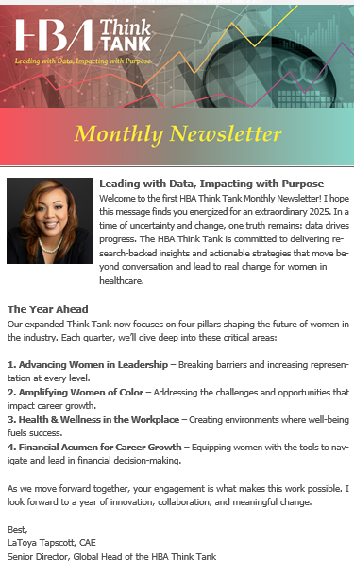

HBA THINK TANK
TITLE
The Think Tank will drive and amplify conversations, and set goals to advance impactful progress on the following issues:
  Holistic approach of addressing of equity for women in healthcare
  Innovation in health equity by women
  Social determinants of health
  Women’s wellness globally
  Global workforce of the future—engaging women earlier in the pipeline
  Financial wellness for women
Don’t miss the new monthly newsletter!
Notes:
Formerly the Gender Parity Collaborative, The HBA Think Tank is an award-winning and growing consortium of healthcare and life sciences companies dedicated to accelerating the advancement of women by fostering and adopting systemic changes in the industry workplace. Together, companies participating in the Think Tank commit to taking an active role in defining strategies, measuring performance, creating change, and inspiring others.
Next up, in case you missed it, the HBA Think Tank is going strong! The HBA Think Tank is a research-driven, collaborative hub dedicated to addressing systemic barriers and advancing opportunities for women in healthcare. As part of the Healthcare Businesswomen’s Association (HBA), the Think Tank equips companies with actionable insights, benchmarking tools, and innovative strategies to foster meaningful change.
Its mission spans four critical areas: leadership representation, amplifying women of color, workplace health and wellness, and financial acumen. Through cutting-edge research, expert collaboration, and customized solutions, the Think Tank empowers organizations to transform their workplaces, enhance health outcomes for women, and lead the way in creating a more equitable healthcare ecosystem
Formerly the Gender Parity Collaborative, The HBA Think Tank is an award-winning and growing consortium of healthcare and life sciences companies dedicated to accelerating the advancement of women by fostering and adopting systemic changes in the industry workplace. Together, companies participating in the Think Tank commit to taking an active role in defining strategies, measuring performance, creating change, and inspiring others.
The Think Tank will drive and amplify conversations, and set goals to advance impactful progress on the following issues:
Holistic approach of addressing of equity for women in healthcare
Innovation in health equity by women
Social determinants of health
Women’s wellness globally
Global workforce of the future—engaging women earlier in the pipeline
Financial wellness for women
Don’t miss the new monthly newsletter where the Think Tank will share updates, data and insights!

Slide 14




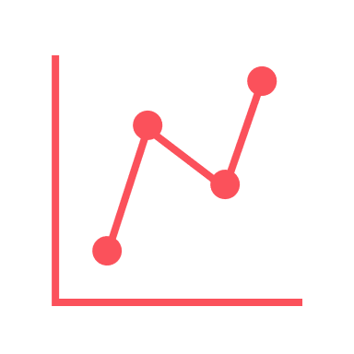

2024 in Numbers
21,000+ Members
1,069 Companies Represented
75 Countries
154 Corporate Partners
10 Think Tank Members
65+ HBA Locations

Slide 15
2024 in Numbers
21,000+ Members
1,069 Companies Represented
75 Countries
154 Corporate Partners
10 Think Tank Members
65+ HBA Locations

Slide 16
HBA Membership Overview
Total Members as of 12/31/2024 = 21,262
Companies Represented = 1,069
Countries Represented = 75

Slide 17
HBA MEMBERS BY INDUSTRY SECTOR

Slide 18
HBA MEMBERS BY INDUSTRY EXPERIENCE

Slide 19
HBA MEMBERS BY ROLE LEVEL

Slide 20
HBA MEMBERS BY ROLE LEVEL

Slide 21
HBA MEMBERS BY LOCATION
Distribution of members who have indicated their home HBA region

Slide 22
HBA MEMBERS BY RACE/ETHNICITY

Slide 23
HBA Corporate Partners Overview
Total Corporate Partners as of 12/31/2024 = 154

Slide 24
HBA CORPORATE PARTNERS BY COMPANY TYPE

Slide 25
Length of HBA Corporate Partnership

Slide 26
HBA Corporate Partners BY LOCATION
Distribution of corporate partners based on corporate HQ or region that manages the partnership

Slide 27
HBA CPs By # of Employees

Slide 28
Watch As We Grow!
Recently Established
Bangalore, India
Barcelona, Spain
Buenos Aires, Argentina
Copenhagen, Denmark
Detroit, Michigan
Ljubljana, Slovenia
Madrid, Spain
Melbourne, Australia
Montreal, Canada
Mumbai, India
Pittsburgh, Pennsylvania
Sidney, Australia
Singapore
Tokyo, Japan
United Arab Emirites (UAE) Dubai
Vienna, Austria
Interest in an HBA Location
Athens, Greece
Bangkok, Thailand
Bogota, Columbia
Cairo, Egypt
Cambridge, United Kingdom
Casablanca, Morocco
Delhi, India
Hyderabad, India
Jakarta, Indonesia
Kuala Lumpur, Malaysia
Lagos, Nigeria
Lisbon, Portugal
Nairobi, Kenya
Orlando, Florida
Portland, Oregon
Rome, Italy
San Juan, Puerto Rico
Santiago, Chili
Seoul, South Korea
Sao Paulo, Brazil
Vancouver, Canada
Warsaw, Poland

Slide 29


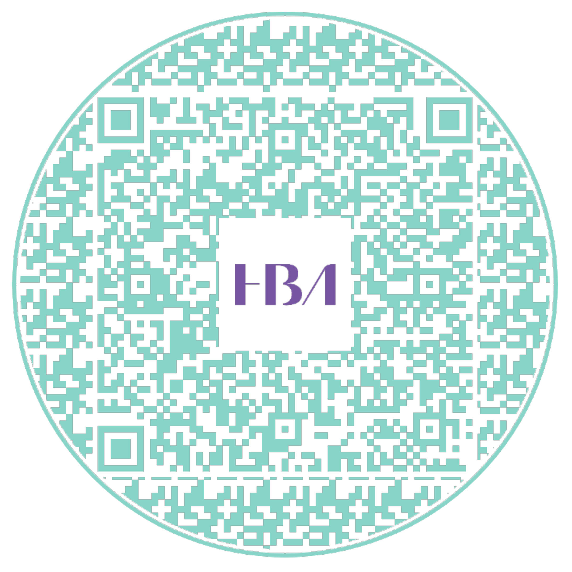
Our Reach
Our Reach
The HBA has expanded its reach to nearly 70 locations*.
For more information on all locations
*as of Jan 2025
Notes:
Maybe just mention expansion celebrations in some key new areas

Slide 30

Katie Cammer
Associate Director
Stakeholder Operations

Slide 31
2025 Timeline
January
JPM/WOTY Reception
February
March
April
May
June
Global Board Meeting
Global Board Meeting
Woman of the Year (9 May)
European Leadership Summit (12-13 June)
Midyear reforecast
International Women’s Day (6 March)
Think Tank Summit (19 March)
Leadership Institute
Career Conversations (CC) 46 (30 Jan)
CC 47 (24 April)
Think Tank Summit (virtual – 11 June)
July
Global Board Meeting
August
Annual Budgeting
September
Annual Conference (29 Sept-1 Oct)
October
November
December
Global Board Meeting
Annual Business Meeting (13 November)
ACE Awards
CC 48 (24 July)
CC 49 (4 Dec)
Think Tank Summit (10 Sept)
Think Tank Summit (virtual – 10 Dec)
Notes:
I’ll walk through our key events and milestones for 2025. We start the year in January with the JPM/WOTY Reception and a Global Board Meeting, setting the tone for our initiatives. February is a quieter month for internal planning, followed by the Think Tank Summit on March 19. In April, we have our second Global Board Meeting to review progress. May brings one of our biggest events—the Woman of the Year celebration on May 9. June features the European Leadership Summit (June 12-13) and the midyear reforecast. In July, we hold another Global Board Meeting to assess midyear performance. August is dedicated to annual budgeting, preparing for the next fiscal year. The Annual Conference from September 29 to October 1 serves as a key networking and learning opportunity. October includes another Global Board Meeting for continued alignment. In November, the Annual Business Meeting on November 13 allows us to reflect on achievements and set future goals. December is a time for finalizing reports and preparing for the transition into 2026. This timeline ensures we stay focused, aligned, and ready for every major milestone ahead.

Slide 32
Planning Timelines
Succession
July
Aug.
Sept.
Oct.
Nov.
Succession worksheets shared with leaders
(End June/early July)
Completed worksheets due to HBA Central
(mid-September)
Call for nominations sent
(early October)
Programs
July
Aug.
Sept.
Oct.
Nov.
Global planning calendar shared
(end June)
High-level plans completed/shared with Regional Treasurer (early Aug)
Detailed Q1 2024 plans due
(end November)
Budgets
July
Aug.
Sept.
Oct.
Nov.
Draft budgets due (early August)
Final budgets due
(end August)
Awards
July
Aug.
Sept.
Oct.
Nov.
July
Aug.
Sept.
Oct.
Nov.
Annual award nomination survey request deadline
Awardees due
(early October)
Notes:
We know that one of the keys to success are staying aligned with our planning milestones. This timeline outlines key deadlines across four focus areas: Succession, Programs, Budgets, and Awards, and provides a structured approach to our planning efforts, ensuring efficiency and alignment across all areas. By meeting these deadlines, we set ourselves up for a successful and well-coordinated year.

Slide 33



Slide 34

2025 ELS Save the Date

Slide 35

2025 AC Save the Date
29 SEPTEMBER – 1 OCTOBER

Slide 36

Lauren Peck
Director
Stakeholder Engagement

Slide 37

2025 Member Leader Resources
Notes:
Thank you Katie. I’m so happy to share with you today a review and some BIG announcements relating to our 2025 Member Leader Resources

Slide 38
2025 Leadership Institute
Phase 2: Connection Sessions
Coming in March 2025!
Functional Connections
Leadership Connections
Sessions organized by functional area
Sessions organized by component-level leadership role (i.e. Chapter DAL, Regional EC, etc.)
Notes:
Firstly, we’re so glad you were able to join us for the first part of our 2025 Leadership Institute, and we’re excited to share that we’re not done yet! LI Phase 2 will be coming in MARCH! The second phase will be our CONNECTION SESSIONS, a two part series of live, interactive sessions to provide space for additional learning, global peer-connections and networking, and best practice sharing. Part one of the series will be our FUNCTIONAL CONNECTIONS: sessions organized by your role’s functional area. The second in the series will be our LEADERSHIP CONNECTIONS, bringing our leaders together by component level leadership role such as chapter director-at large or regional executive committee. More details to follow in the coming weeks.
And now…. Drumroll please… I am very happy to share with you all a big announcement:

Slide 39

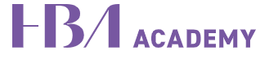
ANNOUNCING
The NEW Leadership Learning Center!
Powered by the
Notes:
Introducing the brand NEW Leadership Learning Center, the HBA’s home for our NEW member training in the NEW HBA Academy! Now I just hit you with a lot of ‘new’ and that’s because it is!!! This is a multi-update update.
YOU ARE AMONG THE FIRST TO HEAR ABOUT AND SEE THE HBA ACADEMY, which is officially launching organization-wide later this month! The HBA Academy is HBA’s learning management system, a resource for HBA members and companies for on-demand educational content, cohort experiences and more! Keep your eyes open for more on the HBA Academy launch, but for now I want to share with you more about…

Slide 40
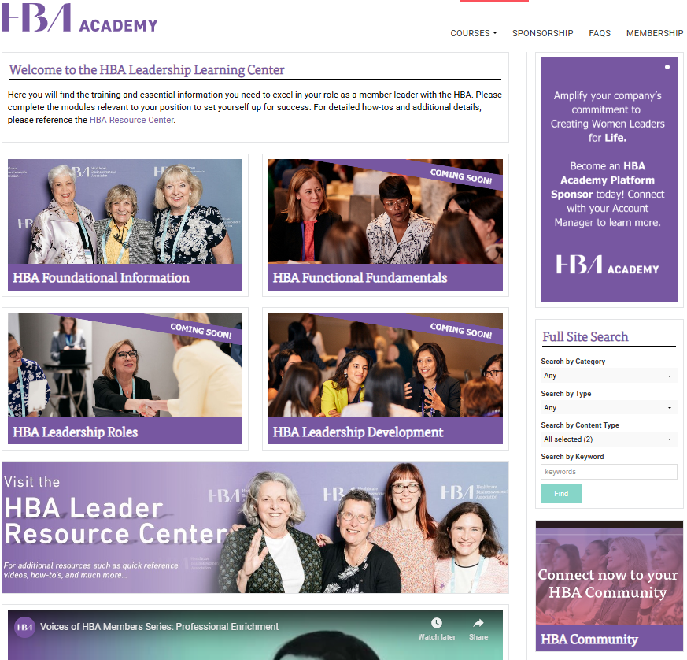
Leadership Learning Center
⭐BOOKMARK IT: academy.hbanet.org/
leadershiplearningcenter
Notes:
The Leadership Learning Center. This is a private section of the HBA Academy only available to HBA member leaders, housing all of the HBA’s new member leader onboarding and training and in future, exclusive free content. The new training and onboarding has been in the works and will formally roll out over the course of the next few months. Our training will feature on-demand modules what can be done at your own pace, with helpful quizzes to reinforce learning. We hope to provide a really wonderful foundation on which our incoming (and existing) member leaders can begin their journeys. Let’s talk a little more about what it will look like once it’s fully rolled out…

Slide 41
NEW Member Leader Onboarding
Highlights
On-demand learning
5-10 min modules
Quizzes to reinforce learning
Foundational Onboarding
Functional Onboarding
Leadership Role Training
Leadership Development
Component deep-dives
Leadership role responsibilities
NOW AVAILABLE
The basics
NOW AVAILABLE!
The basics of the HBA organization.
Coming soon!
High-level reviews of HBA’s functional areas, including definitions, purpose/priorities, focus areas, tactics, and resources.
Coming soon!
Component deep dives and leadership role responsibilities.
Coming soon!
Member Leadership best practices and continuous development.
… and a restructuring of the HBA Resource Center coming soon as well!
Notes:
The new member leader onboarding experience will be completed in four phases:
Phase 1 is HBA’s Foundational training, which is NOW AVAILABLE and reviews the basics of the HBA organization. Phase 2 dives into the individual’s functional area, with high-level reviews of the function, definitions, purpose/priories, focus areas, top tactics and resources. Phase three ties everything they learned together – our Leadership Role training will dive into the individual’s component level (i.e. chapter, region, etc) and their role responsibilities within it. And finally, the HBA will be developing Leadership Development modules, featuring member leadership best practices and continuous development as an exclusive member leader benefit. Depending on the individual’s role, there may also be additional tactical trainings to be completed to ensure they are entirely set up for success!
All of this will be complimented by a restructuring of the HBA Resource Center, to help our member leaders find what they need when they need it. It will be organized similarly to our member leader onboarding for ease of understanding and navigation – and our handy search feature isn’t going anywhere!
One item to note is this training and onboarding is for member leaders across the globe – so it is designed to be evergreen and relatively high-level, including information and details that are the ‘universal truths’ of the HBA. Every geography, region and location may still need to do some orientation of new member leaders to ensure that they understand how this information translates in your areas. That said, we hope this new training alleviates a huge burden on all our member leaders and helps to set everyone up for success!

Slide 42
HBA Foundational Onboarding Topics
NOW AVAILABLE!
All Leaders: please complete
HBA Basics: history, mission, vision and stakeholders
What HBA Does: the HBA experience
HBA Organization: components, structure, and functions
Member Leadership Fundamentals: skills, culture, and expectations
What’s In It For Me: maximizing your member leadership experience
Member Leader Resources: communications, tools and support
Notes:
And as you just saw, our brand new HBA Foundational Onboarding, is NOW AVAILABLE! During this first phase, you’ll find six short training modules on various topics foundational to the HBA:
HBA Basics: history, mission, vision and stakeholders
What HBA Does: how our members and customers experience the HBA
HBA Organization: components, structure, and functions
Member Leadership Fundamentals: skills, culture, and expectations
What’s In It For Me: maximizing your member leadership experience
Member Leader Resources: communications, tools and support along your journey
The total run time of these modules is only 50 minutes, so you should be able to complete in under an hour! At the end of each module will be a short quiz to test your learning.
Whether you’re brand new to the HBA or if you’ve been here for 20 years, we ask all member leaders to complete the new HBA Foundational training! The HBA has changed massively over the years, so this foundational onboarding will be a great refresher on all the HBA is and all that it does, plus there is some fantastic new content about our member leadership cultural norms, tips on maximizing the experience utilize all the resources at your fingertips.

Slide 43

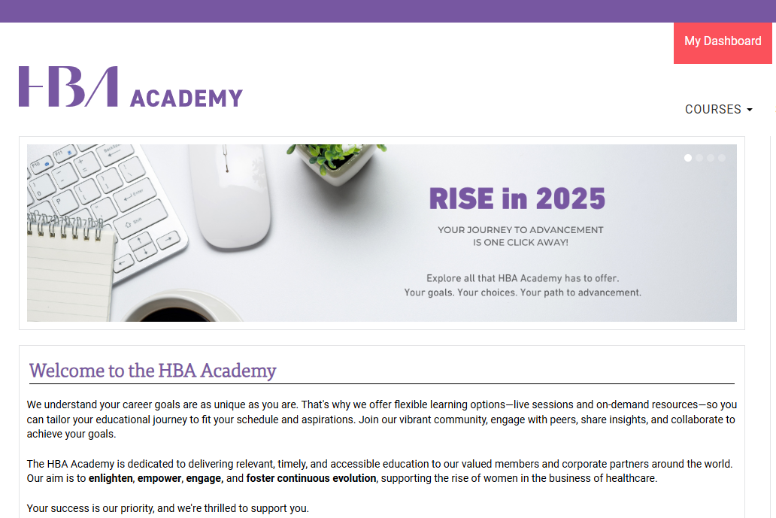
HBA Academy – Your
Training Hub!
⭐BOOKMARK IT: https://academy.hbanet.org/leadershiplearningcenter
Notes:
So give it a go – visit the HBA Academy Leadership Learning Center today and complete your HBA Foundational Onboarding! The new functional and leadership role training will also be released in the coming months.

Slide 44
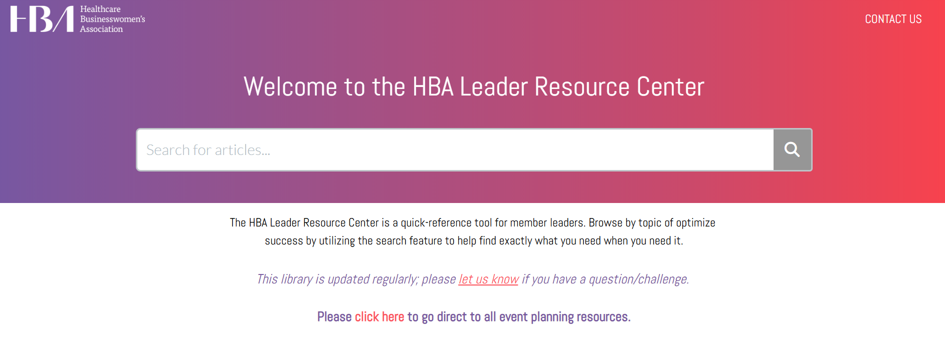
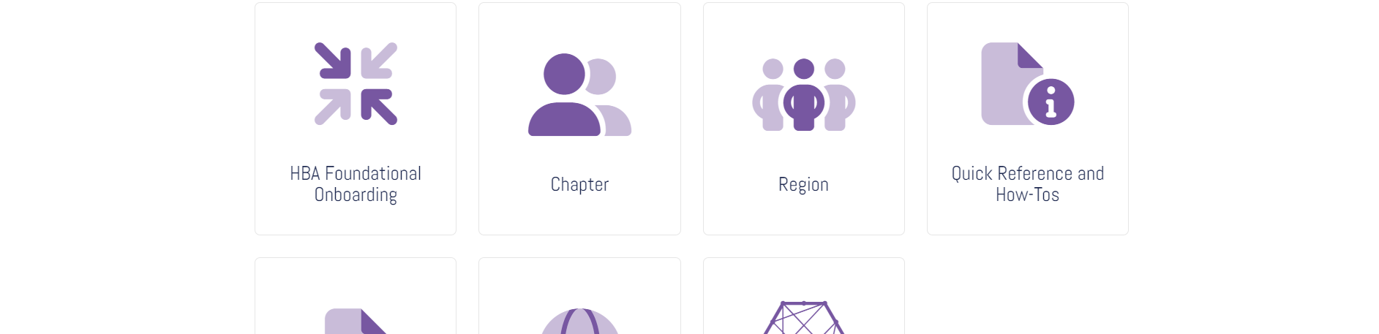
HBA Resource Center – Your Go-to Help Spot!
⭐BOOKMARK IT: https://hbavolunteer.knowledgeowl.com/help/
Notes:
And while we’re talking about your resources, we also want to remind you about the HBA Leader Resource Center (formerly the Volunteer Resource Center). For those of you who may be new, is a knowledge base populated with hundreds of articles, tools, templates, and resources to help you in your member leadership role. This should be your first stop whenever you have questions or when you need something. This houses all of HBA’s non-proprietary resources across all HBA functional areas and components, along with important references and policies. It offers a helpful search function as well to help you find what you need as quickly and easily as possible. If you’re completely new to the HBA, we highly recommend taking a few minutes to get oriented within the Resource Center. As mentioned, it’ll be getting a bit of a new look soon, but that will only make it even better!

Slide 45
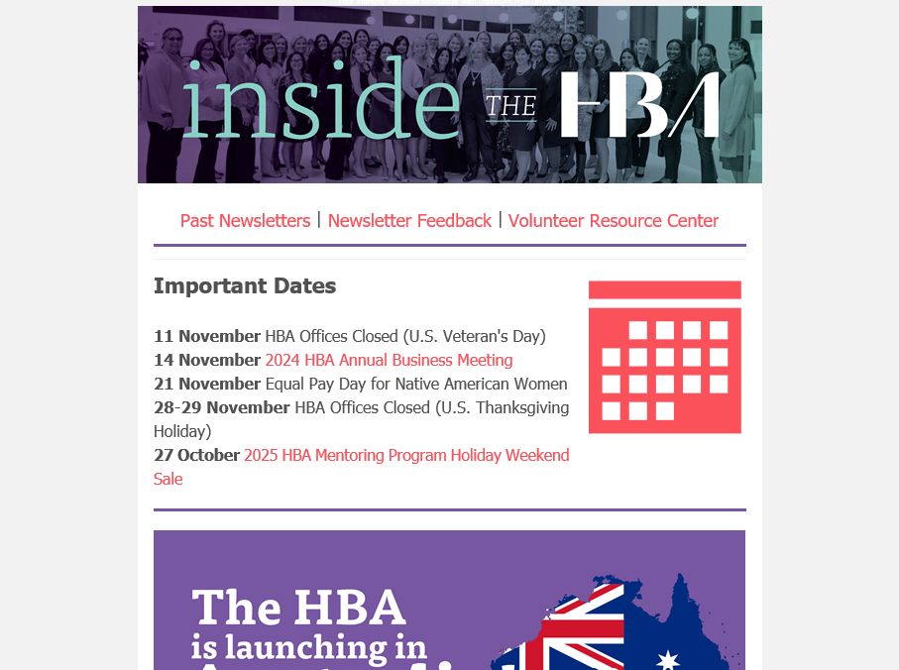
Inside the HBA – Leadership Newsletter!
⭐MONTHLY NEWSLETTER: delivered right to your inbox!
Notes:
And finally, want to stay informed about what’s going on across the HBA? Never miss a thing with the INSIDE THE HBA, your monthly leadership newsletter. All of the HBA’s most important news, dates and announcements, delivered right to your inbox! Prioritize spending ten minutes a month getting Inside the HBA to ensure you’re up to date with key dates, updates, and important goings-on. This newsletter critical to your journey, as it is how the HBA keeps our member leaders informed. Ever feeling out of the loop? Maybe you missed that month’s newsletter! Past issues of the Inside the HBA can be found in the Resource Center.

Slide 46
Questions/Comments
Notes:
And with that, our presentation is done and I believe we have a few minutes left for Q&A. Back to you Barb
Barb is point for Q&A, but Katie/Lauren raise hand to take a question if it falls in our area.

Slide 47

Notes:
Barb handle closing: Thank you for all you do for the HBA! As a reminder: you will receive a follow up email this week with the recording, slides and direct links to all resources we’ve mentioned during the session today.

Slide 48
Notes:
Barb: Have a wonderful rest of your day

