Slide 1
2023 Woman of the Year Event
Post-Event Survey Analysis

Slide 2
Attendee Survey

Slide 3

Respondent Demographics – 182 Responses
Note: The respondent demographics are not reflective of all attendees – demographic info is not collected for table seat attendees

Slide 4
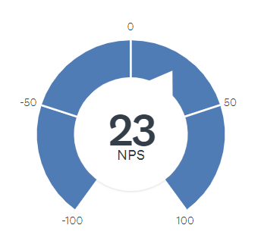
Attendee Satisfaction and NPS
Net Promoter Score: a measure of likelihood of recommending something to a friend. Ranges from -100 to +100 with a positive number indicating more promoters than detractors.
The creators, Bain & Company, suggest that anything above 0 is good, above 20 is favorable, above 50 is excellent, and above 80 is world class.
According to SurveyMonkey's global benchmark data, which accounts for the NPS of more than 150,000 organizations, the average score is +32.
84.83% of respondents were satisfied with their experience
Attendees continue to be broadly satisfied by the overall WOTY experience. Satisfaction did not differ among various segments.

Slide 5
Factors Influencing Attendance
Attendees choose WOTY for inspiration and networking. Honorees are a draw for attendees.
83%
of attendees stated that their trip to NYC did not include vacation plans

Slide 6
Event Ratings – In-Person
The highest rated aspects of the event were related to the event program and the location of NYC. Venue-related aspects were less favored by guests.
Percentage of respondents rating an element as “Very Good” or "Excellent"

Slide 7
Event Ratings – Virtual
Virtual attendees appreciated the ability to watch the event from their location, however the engagement and networking aspects received lower ratings.
All open-ended feedback about their Networking Reception was positive, "The reception was great opportunity to meet other colleagues and get inspired by them" with critical feedback asking for more awards show engagement, "More interactive activities during the event, not only the reception"
Percentage of respondents rating an element as “Very Good” or "Excellent"

Slide 8
Attendee Comments – What Worked Well
Speakers – “Loved the strong sense of purpose” “The speakers were just absolutely inspiring”
RSL Reception – “It was extremely well facilitated and provided opportunities to network and connect”
Logistics/Flow – “Check in [was] so easy with the computers and printing of badges” “The agenda was well thought through”
Location – “Location was convenient” “The location is easy to travel to for the day, and ending at 2pm allowed time to work and get home”
Celebration and Recognition – “it was nice to see the Rising Stars and Luminaries receive recognition” “Honoring and celebrating colleagues”

Slide 9
Attendee Comments – Areas to Improve
Food Quality/Service – “the food was stone cold and the lunch overall and service were very disappointing” “no wait staff, no drink refills, no accommodations for non-meat eaters” "Coffee at the morning breakfast/networking selection is a must"
Networking Difficulties– “Networking events on different floors wasn't ideal” “more structured networking” “challenging to meet new contacts”
Venue – “very crowded at the tables” “Seemed overcrowded and networking jam packed” “need better accessibility for wheelchairs”
Virtual Platform – “never received the virtual link” “technical difficulties that prevented me from joining virtually”

Slide 10
Satisfaction vs. Loyalty Matrix
 |  | Level of Satisfaction
 |  | Not at all satisfied | Not very satisfied | Somewhat satisfied | Very Satisfied
Do you plan to attend again? | Yes | 0 | 1 | 26 | 65
 | No | 1 | 2 | 1 | 1
This matrix plots a customer’s level of satisfaction with their likelihood of future attendance
Most respondents fall into the “truly loyal” quadrant – they are satisfied and plan to continue attending

Slide 11
Preferred Future Location
The preferred location continues to be New York City. Pacific region members prefer Los Angeles and comprise a large portion of members.

Slide 12
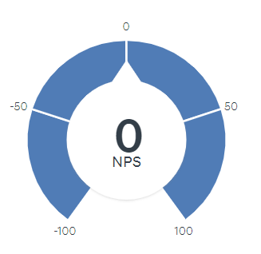
RSL Experience
Net Promoter Score: The creators, Bain & Company, suggest that anything above 0 is good, above 20 is favorable, above 50 is excellent, and above 80 is world class.
According to SurveyMonkey's global benchmark data, which accounts for the NPS of more than 150,000 organizations, the average score is +32.
When segmenting RSL respondents, we see a similar rate of satisfaction with the event overall. The NPS score is lower, with a 0 indicating the RSLs are equally likely to recommend the event to a colleague or not. This could be because the RSLs were specifically invited to the event by their company.
80% of RSLs were satisfied with their experience

Slide 13
RSL Feedback
Positive feedback and areas for improvement were in line with the comments from all attendees
Suggestions for added value include:
More structured networking (top request)
Adding LinkedIn QR code to badges to facilitate connections
Workshops/Learning opportunities, more content
Ability to meet the Woman of the Year

Slide 14
Male Attendees
Very low response rate (3 in person, 1 virtual) for male attendees
Those who did respond were highly satisfied (NPS of 100, 100% rated “Very Good” or “Excellent”
Hard to draw any additional conclusions for this group due to the small sample size

Slide 15
Sponsor Survey

Slide 16
Sponsorship Packages
The most important opportunity for sponsors is access to the event. Visibility (both digital and in-person) are tied for second, with content being somewhat important to many, but not a must-have for any sponsor.

Slide 17
Sponsor Experience
 | POOR | FAIR | GOOD | VERY GOOD– | EXCELLENT | DON'T KNOW/NOT APPLICABLE
Overall Value |  |  | 4 | 1 | 2
Clarity of Sponsorship Package Options |  | 2 | 3 | 1 | 1
Sponsorship Sales Process |  | 2 | 1 | 2 | 1 | 1
Sponsors found the package options to be a good value, though there is room for improvement in clarity of options and the sales process.
Need to have longer lead time for updating Winner bios/titles/names as there are always changes in organizations. Need to add DIGITAL ACCESSIBILITY to entire program - closed captions on all videos and live CART as well - plus ASL interpreter.
The details of the various options included in the sponsorship were not so clear, and many needed action and deliverables from sponsor in the last minute. Having more time and clarity on actions needed from sponsor will provide a seamless experience.

Slide 18
Staff Survey

Slide 19
Event Ratings – Staff
In line with the attendee ratings, program-related aspects were highly rated while venue ratings were lower.
Large number of “I don’t know”/NA
Percentage of respondents rating an element as “Very Good” or "Excellent"

Slide 20
Staff Feedback – Event
What worked well
Stanchions at appreciation station
Staff event post WOTY
Early ballroom access
Event tour/staff briefing
Needs improvement
Acknowledge VIP leaders more (board, regional chairs, sponsors)
More directional signage (easels) and correct event name on signs (“Women of the Year”)
Better/bigger venue
Separate RSL celebration
Easier table reg process
These are some common trends that vary from attendee feedback, and not an exhaustive list of comments. The team has received/reviewed all feedback submitted by staff.

