Slide 1
Healthcare Businesswomen’s Association 2025

Slide 2




For nearly 50 years, the Healthcare Businesswomen’s Association has pursued its mission of furthering the advancement and impact of women in the business of healthcare. That mission is just as relevant now as it was 50 years ago. From its inception, HBA membership and programs have always been open to anyone who wants to become a member.
Located in 80 locations, the Healthcare Businesswomen’s Association is a trusted voice and partner across the healthcare industry, assisting with seamless connectivity of groups, leaders, teams and stakeholders around the world while advancing patient access to healthcare.
The Healthcare Businesswomen’s Association is a global organization, with a presence spanning the globe. The HBA supports nearly 150 Corporate Partners and a collective workforce of approximately five million employees.
The Healthcare Businesswomen’s Association Think Tank brings together stakeholders from across the healthcare ecosystem to address healthcare challenges and use data to find solutions.
The Healthcare Businesswomen’s Association launched HBA Academy, its Digital Learning Platform, that enables advancement of leaders in healthcare around the world with over 142 courses and more than 25,000 views per quarter.

Slide 3



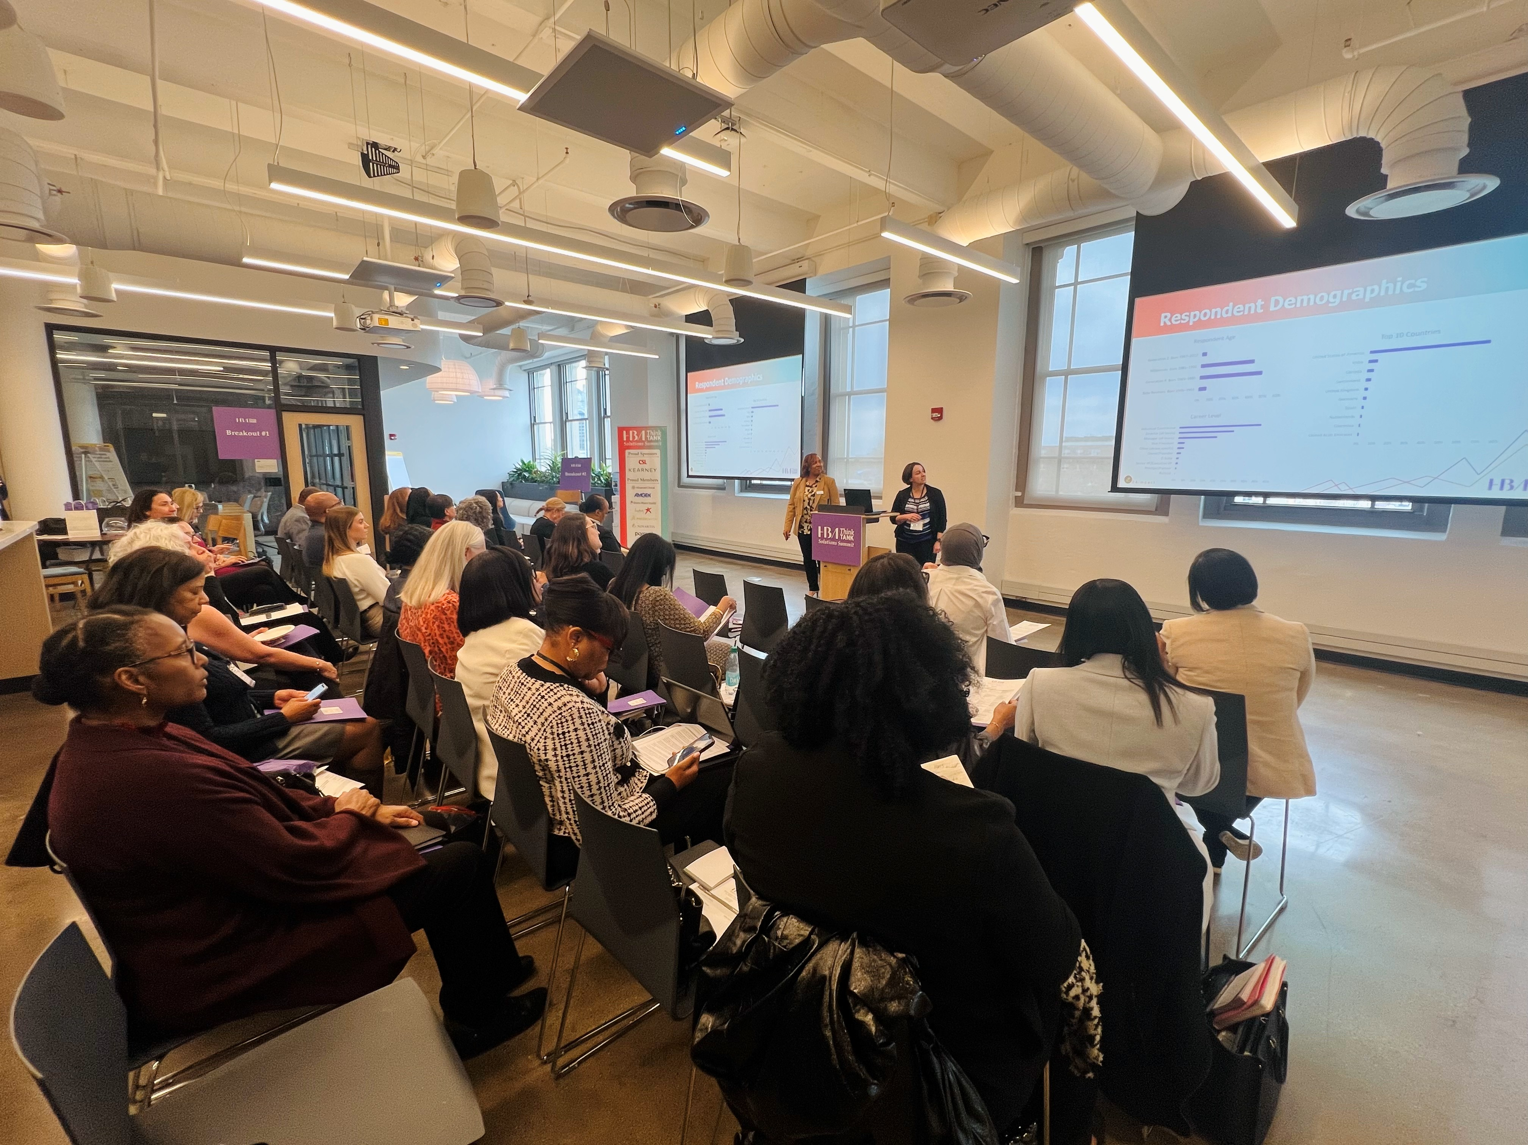
The Healthcare Businesswomen’s Association is focused on Leadership, Innovation, and Business Impact. This means:
Positioning the HBA
Executive Development
Building Future Leaders
Driving Business Results
The Healthcare Businesswomen’s Association is a leadership accelerator, talent pipeline, and business growth partner for the healthcare industry.
Focusing on executive development, mentorship, and strategic networking that drives business outcomes.
Highlighting the role of the Healthcare Businesswomen’s Association in developing the next generation of healthcare leaders.
Using data and case studies to show how membership with the Healthcare Businesswomen’s Association correlates with stronger business performance, innovation, and industry leadership.

Slide 4

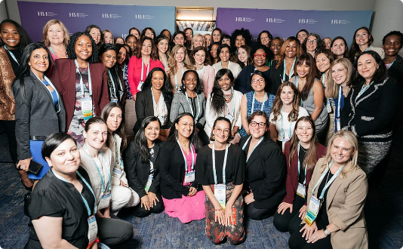


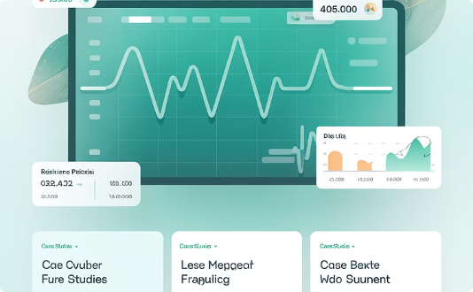

WHY – The Business Imperatives
Healthcare companies must address several critical business imperatives:
Workforce Trust & Confidence
Employee Development & Retention
Patient & Community Trust
Companies must secure workforce confidence and trust; reinforcing that enables maximum performance and productivity.
Companies must do the actual work to retain, engage, and develop all employees to ensure ongoing productivity, performance, innovation, and patient centricity.
Companies must maintain trust with patients, advocates,
and community partners by maintaining a workforce that is representative of the patients and communities we serve.
Stakeholder Relationships
Business Performance Impact
Mutual Commitment
Companies must be mindful to continuously engage key stakeholders—the very customers, partners, and employees who companies depend on.
A company's ability to retain a highly skilled and productive healthcare workforce directly impacts patient outcomes, business performance, reputation, and revenue.
Just as employees are expected to merit their jobs, companies must merit those employees choosing to work for them by demonstrating commitment and enabling the highest performance.

Slide 5
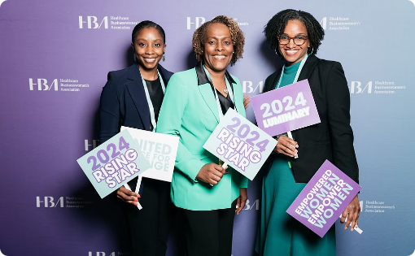


HOW – Helpful Tips
Essential work remains critical for business success:
Focus on Describing the Work
Key Implementation Strategies
Utilize Established Resources
Describe the actual work to make healthcare accessible to all patient populations with a focus on addressing health disparities to achieve business objectives.
Make programs available to all employees. Leverage data to identify barriers to achieving business impact. Articulate why initiatives drive business outcomes, engagement, retention, and productivity.
Leverage the Healthcare Businesswomen’s Association, which has been doing this necessary and beneficial work for nearly 50 years and has consistently made its offerings open to all employees.

Slide 6



The Value of the Healthcare Businesswomen’s Association
For nearly 50 years, the HBA has built a solid reputation as a business partner that helps companies develop, reward, and recognize its employees and engage civic and industry stakeholders in countries around the world.
Healthcare Workforce Leadership
Talent Engagement & Retention
Career Development & Leadership
Women represent 80% of the healthcare workforce in the U.S., 67-70% globally, and 90% of caregivers. The Healthcare Businesswomen’s Association has 150 corporate partners who represent approximately five million employees worldwide.
The Healthcare Businesswomen’s Association develops programs to enhance employee engagement, retention, and loyalty by investing in leadership and career development opportunities for both men and women, driving greater productivity and sustained workforce performance.
The Healthcare Businesswomen’s Association delivers impactful career and leadership development, mentoring and coaching programs offered in tandem with women and men to benefit all employees, ensuring a strong pipeline of talent.

Slide 7



The Value of the Healthcare Businesswomen’s Association
HBA Academy & Digital Learning
HBA Think Tank Research
Advancing Women's Health
The Healthcare Businesswomen’s Association launched HBA Academy, a digital Learning Management Platform that provides healthcare industry-specific development and career upskilling opportunities for employees in global and remote locations.
Through its HBA Think Tank, the Healthcare Businesswomen’s Association generates key insights about unique differences across countries that help global leaders set market and workforce strategies to achieve business objectives.
The Healthcare Businesswomen’s Association focuses on closing the gap between women’s and men’s health, addressing challenges from exclusion in clinical trials and lack of data on hormonal impacts to disease management, representing a critical mission given women's roles across healthcare.
Notes:
Must focus on advancing women’s health because data shows women are the majority of the HC workforce, women have the biggest health gaps and are less healthy than men, have poorer health outcomes and as such, there is massive impact to societies globally if the women’s health gap is not closed.

Slide 8


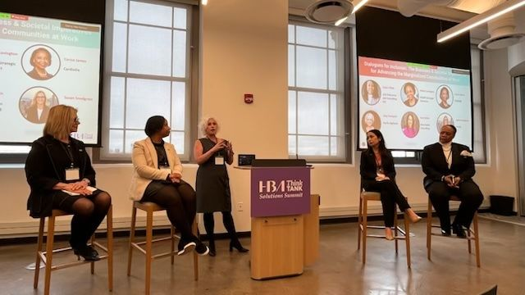
The Healthcare Businesswomen’s Association: Global Impact
Global Expansion
Global Digital Learning
Women's Health Research Initiative
Geographic Operating Boards provide regional oversight in North America, EMEA, APAC and (soon-to-come) Latin America.
Delivering world-class educational resources and development opportunities through innovative digital platforms accessible to healthcare professionals everywhere.
Dedicated to addressing the critical gap between women's and men's healthcare outcomes through rigorous research, evidence-based advocacy, and strategic partnerships.

