Slide 2
Content Summary
An HBA Overview
The HBA's Global Reach
Education and Networking
Signature Programs
Signature Events
Corporate Partnership
Contact Information

Slide 3
An HBA Overview

Slide 4
About the HBA
Founded in 1977, the Healthcare Businesswomen's Association (HBA) was born out of a bold vision by five visionary leaders who recognized the critical need for women in healthcare to connect, share industry insights, and cultivate career growth through mentorship and mutual support. Starting from informal meetings, their shared vision quickly blossomed into a robust community, laying the groundwork for the establishment of the HBA.
Today, nearly half a century later, the HBA stands as a United Force for Change. As a global leadership accelerator, talent pipeline, and business growth partner for the healthcare industry, the HBA connects diverse professionals—women and men from every facet of healthcare and life sciences—in a network unified by purpose. Our members collaborate across disciplines and continents, driving strategic advocacy and offering unparalleled opportunities for executive development and tangible business results.
The Healthcare Businesswomen’s Association has pursued its mission of furthering the advancement and impact of women in the business of healthcare. That mission is just as relevant now as it was 50 years ago. Since its inception, HBA membership and programs have always been open to anyone who wants to become a member and join our United Force for Change.

Slide 5








HBA History
1979
1990
2000
2007
2017-19
2022
Present Day
1977
The HBA is founded in the United States
The HBA is established as a 501(c)6
The first Woman of the Year event is held in New York City
The first HBA Chapter is launched in Atlanta, Georgia
The HBA expands into Europe
A new operating model expands the HBA’s footprint from 15 to more than 50 locations
The HBA expands into Asia Pacific
The HBA serves more than 80 locations across 6 continents

Slide 6
The HBA's Mission, Vision, and Core Values
Mission Statement
To Further the Advancement and Impact of Women in the Business of Healthcare
Vision Statement
Creating Healthcare Leaders For Life
Core Values
Visionary
Innovative
Inclusive

Slide 7



The HBA's Mission in Action
Empowering
Leaders
Equipping Companies
Enabling Systemic Change
Members & Member Leaders
Networking and Educational Events, Mentoring, Volunteering, Supportive Global Community
Corporate Partners
Employee Development Programs, Awards and Recognition, Cross-Industry Business Network and Visibility
The HBA Think Tank
Benchmarking Data, Global Council Meetings, Solutions Summits, Reports, Papers, Toolkit Publications, Advocacy
Notes:
Achieving HBA’s mission is a multi-pronged approach: empowering individuals, equipping companies, and enabling systemic change. The HBA does this through programs and offerings designed for each of our key stakeholder groups, which represent a global workforce of more than six million professionals across the healthcare ecosystem. These stakeholders include individual members, Corporate Partners, and HBA Think Tank members.
For individual members, the HBA serves women and men in the business of healthcare who strive to advance their careers. We offer career resources, volunteer opportunities, and an invaluable network that empowers business professionals of all backgrounds to grow. When you are part of the HBA, you are empowered to advance your career, your company, and gender parity as a catalyst for change across the business of healthcare. We do this through Networking and educational events, Affinity Groups, development Programs, member leadership opportunities, Community and more
For HBA Corporate Partners, HBA’s initiatives and community of industry leaders and peers help companies advance their women further, faster. When companies partner with the HBA, they strengthen the company’s commitment to advancing women, enhance their competitive edge, and become a catalyst for change.
And finally, HBA Think Tank members are a consortium of healthcare and life-sciences companies dedicated to accelerating systemic change. Through benchmarking data, solutions summits, strategic initiatives and advocacy, HBA Think Tank member companies don’t just advocate for change – they drive it.
Lets talk about each of these stakeholders in a little more detail…

Slide 8
The HBA's Global Reach

Slide 9
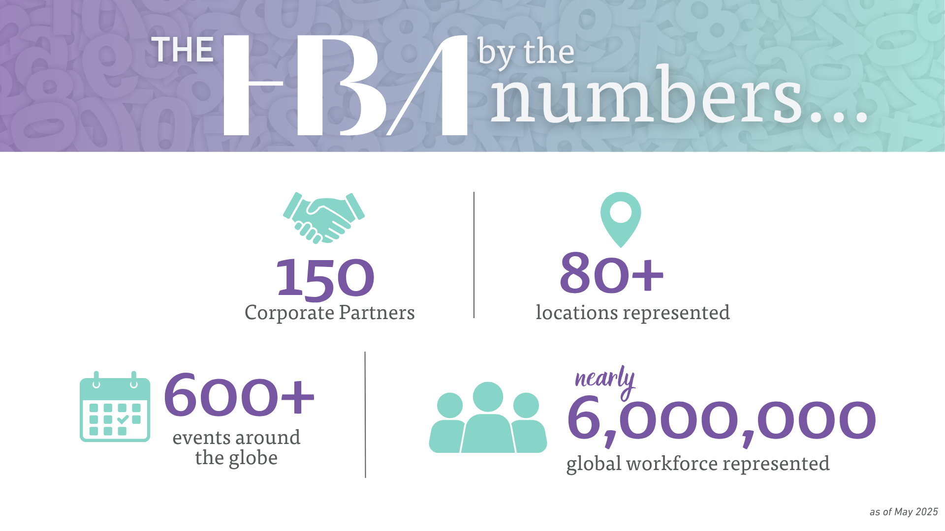

Slide 10


Our Reach
The HBA's Global Reach
The HBA has expanded its reach across 6 continents.
For more information about all HBA locations, click here
or scan the QR Code below.

Slide 11
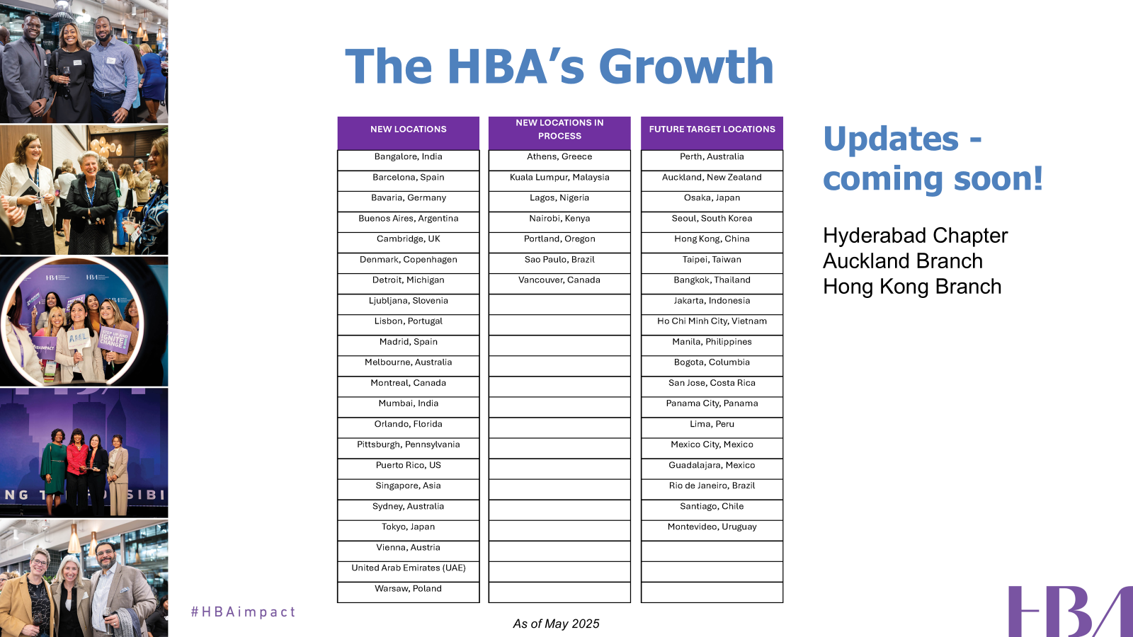

Slide 12
Membership

Slide 13

The Value of Your HBA Membership
Membership Benefits:
Exclusive networking events
Discounts on hundreds of educational programs
Invitations to member-only events like the HBA Annual Conference
Access to virtual platforms such as HBA Academy, online member directory, Community Forums, Career Center, and resource library
Opportunity to join affinity groups based on your interests, career stage, and background
Member-only programs like the Mentoring Program to enhance your professional success
Explore Member Leadership opportunities to broaden your professional experience and gain industry visibility
Receive recognition of leadership contributions through Member Leadership awards
Enjoy unique opportunities through HBA partners who can boost your next bold move
Steer the future and governance of the Association by nominating leaders and exercising voting privileges in the Annual Business Meeting
Access to 600+ events and programs each year that offer opportunities to accelerate career development, celebrate success, and foster networking with industry peers and influencers
Notes:
HBA members are the individual professionals engaged with the HBA across the healthcare ecosystem. Being a part of HBA means members gain access to a host of benefits designed to support their professional and personal growth. Here’s what membership includes:
Exclusive networking events where you can connect with like-minded professionals and expand your circle.
Discounts on hundreds of educational programs, making learning more accessible and affordable.
Invitations to member-only events, including the prestigious HBA Annual Conference.
Access to virtual platforms such as the HBA Academy, the online member directory, community forums, Career Center, and a comprehensive resource library.
Opportunities to join affinity groups, tailored to your interests, career stage, or background, to find your tribe within the organization.
Participation in member-only programs like the Mentoring Program, helping you enhance your professional journey with guidance from experienced leaders.
A chance to explore member leadership opportunities, broadening your professional experience while gaining visibility in the industry.
Recognition for your contributions through member leadership awards.
Access to unique opportunities through HBA partners, who can support your next bold career move.
Finally, you get to steer the future of the association by nominating leaders and exercising your voting privileges during the annual business meeting.
Each of these benefits is designed to empower the individual member, help them grow, and amplify their impact in the business of healthcare. With HBA membership, you’re not just joining an organization — you’re becoming part of a powerful network of healthcare leaders

Slide 14

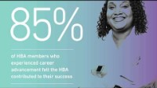
Why Belong to the HBA?
Notes:
Let’s hear it direct from some of our members…

Slide 15
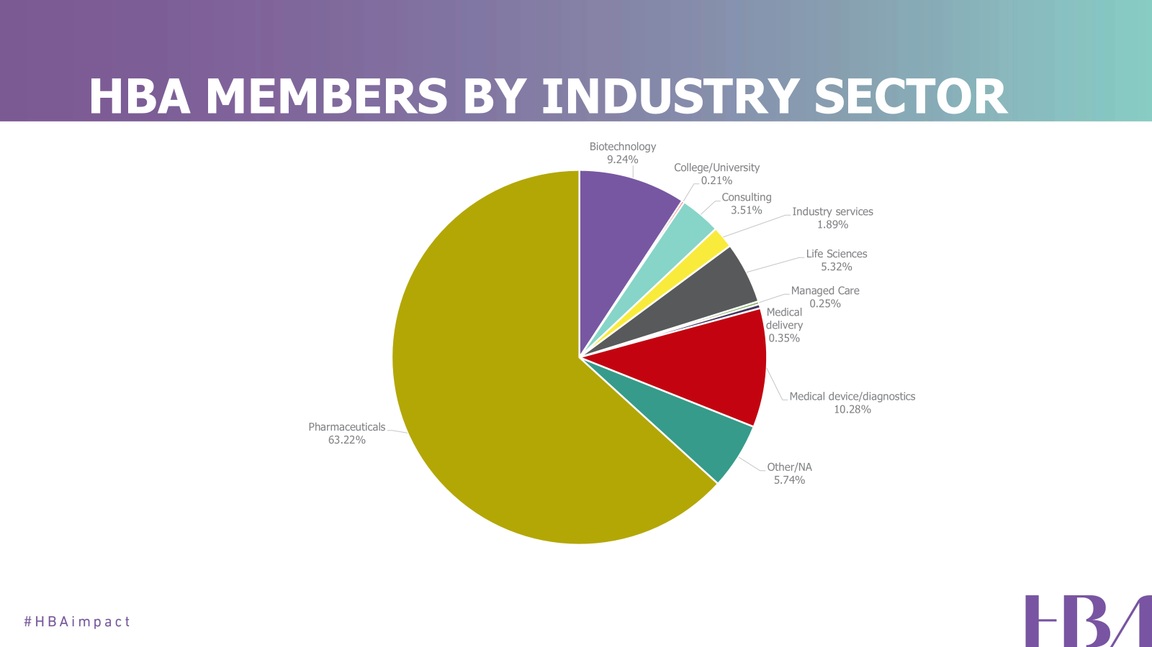
As of 31 December 2024

Slide 16
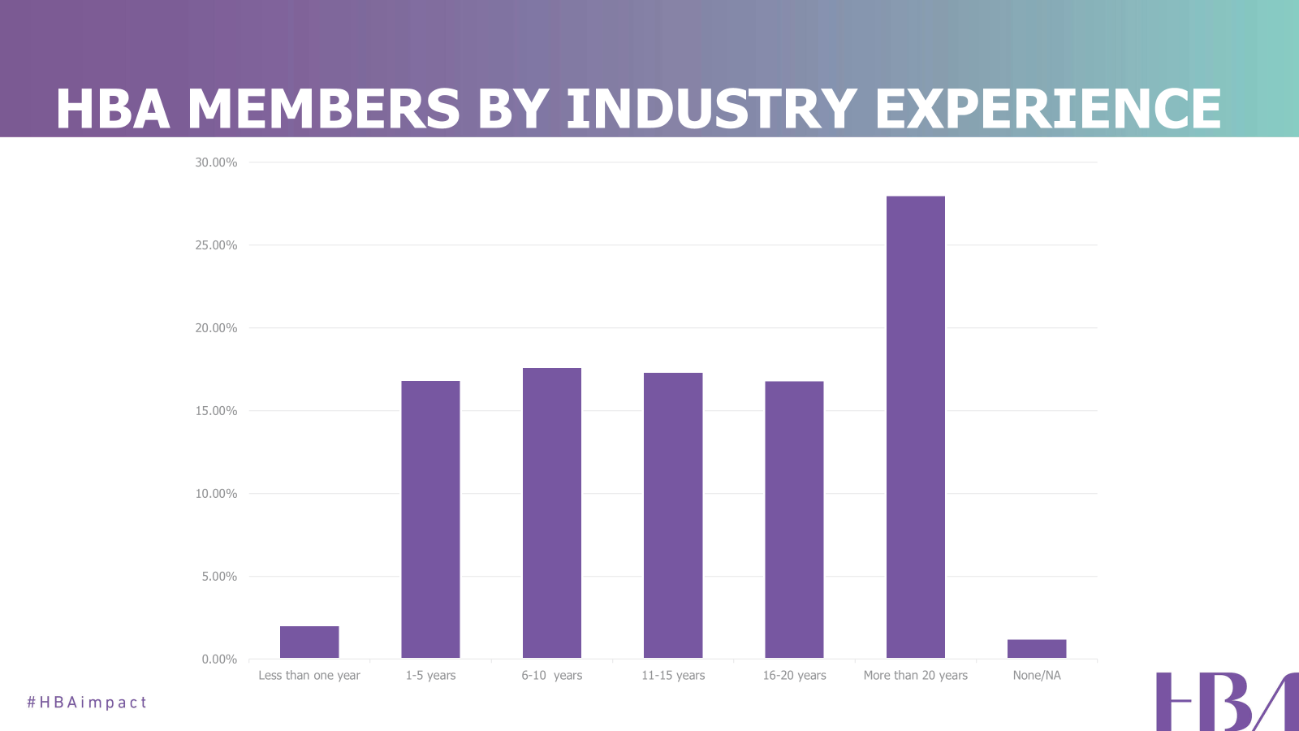
As of 31 December 2024

Slide 17
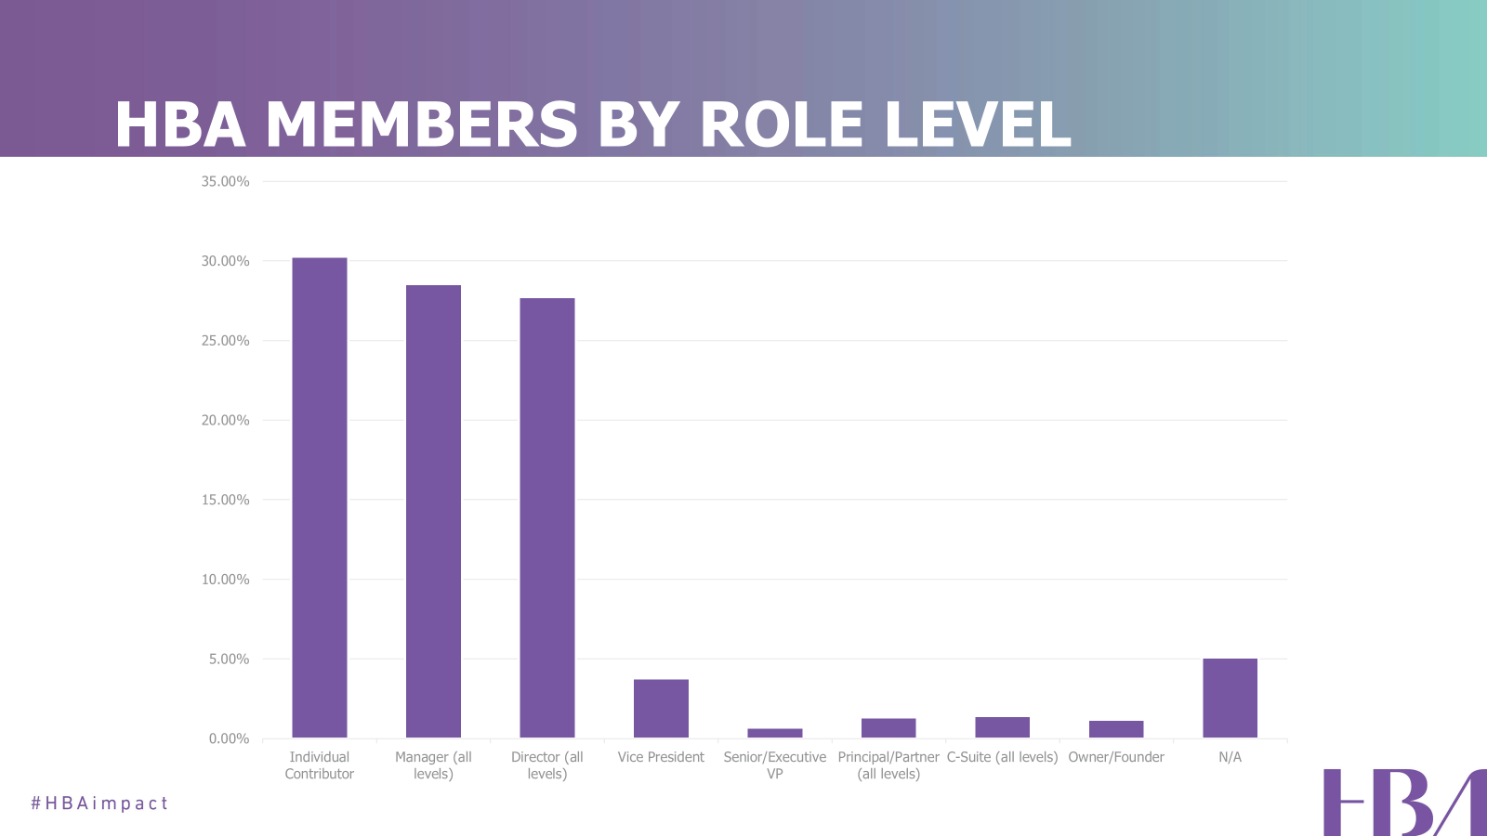
As of 31 December 2024

Slide 18
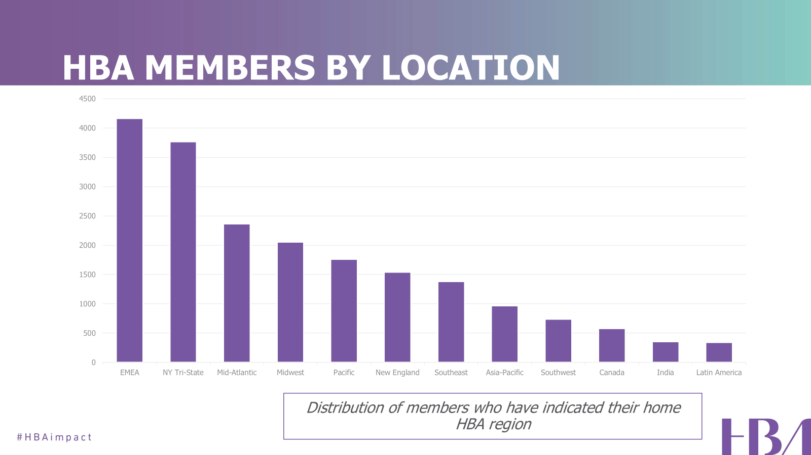
As of 31 December 2024

Slide 19
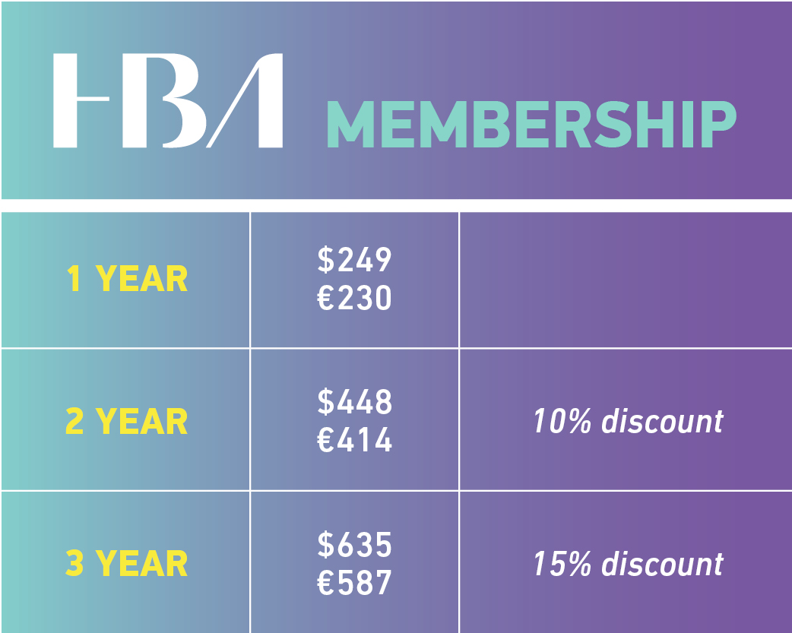
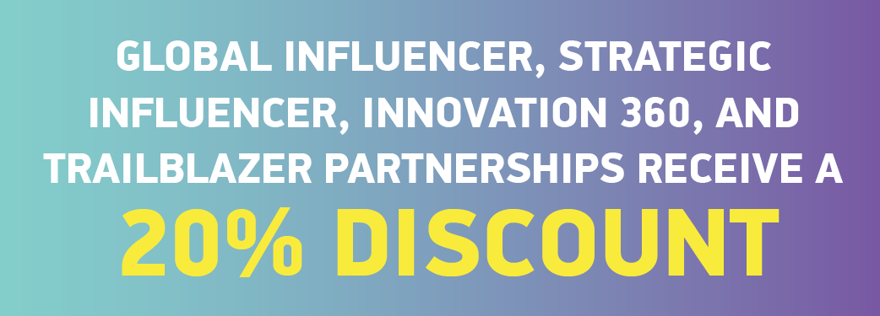
Individual Membership Fees
*The HBA is proud to offer a membership rate of $125/€110 per year for those 30 and under, which includes all benefits of full membership except voting in the Annual Business Meeting and the ability to serve on boards. Additional discounts do not apply to this membership type. Subject to verification at the time of purchase.

Slide 20
Education and Networking

Slide 21



Expert-Led Courses: Gain insights from industry leaders, leading scholars, and highly sought-after coaches.
Interactive Cohort Experiences: Connect with peers across the global healthcare ecosystem through live, remote events and online communities.
Tailored Content: Engage in learning with practical applications for leaders in the healthcare industry.
Flexible Formats: Choose from a variety of offerings that are available live and on-demand at times that are convenient for you.
Personalized Path: Create a customized learning journey aligned with your professional goals.
Log into HBA Academy and start your learning journey: https://academy.hbanet.org/
Notes:
Next up we have the HBA Academy, the HBA’s online learning management system with content designed exclusively for women and allies in the business of healthcare. This is your platform to unlock your potential while advancing your career, building your network, and making your impact in the industry. Featuring expert-led courses, interactive cohort experiences, tailored content, flexible formats, and personalized learning paths, the HBA Academy has something for everyone.

Slide 22
The HBA's Affinity Groups
Affinity groups are self-forming communities of HBA members who connect through a common interest, focus, or need associated with their career and professional aspirations.
Participation in the HBA’s career-specific affinity groups grants members access to professional development through networking, education, and career support.
Affinity group events are a value-add for members only.
For an updated list of HBA affinity groups, please visit the HBA website here.

Slide 23


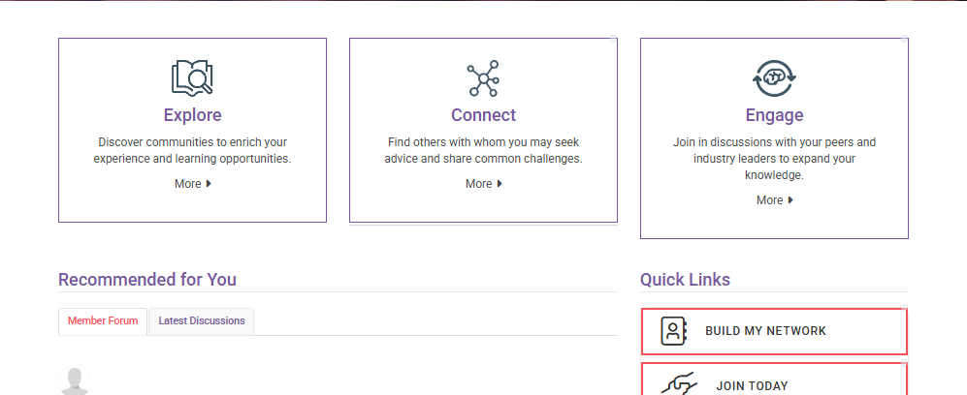
HBA Community
Your Virtual Networking Hub
Visit Community.HBAnet.org
Notes:
Collaborate and connect with peers across the HBA via the HBA Community. Access our member directory, member forum, AG community spaces and much, much more! Build your network, engage with healthcare professionals globally and explore member leadership opportunities to get involved! Get started today by vising community.hbanet.org

Slide 24
Career Conversations
Join us for quarterly virtual conversations that transcend conventional boundaries by exploring the pivotal discussions that propel leaders forward!
The 2025 HBA Career Conversations webinar series, Rise and Shine, is your blueprint for becoming an unstoppable force in leadership.
Join us to experience stimulating dialogue, gain insights, and connect with peers in quarterly virtual sessions crafted to stimulate growth and transform apprehension into empowerment.
Learn more about Career Conversations here.

Slide 25
Signature Programs

Slide 26


Join a powerful network that has empowered more than 7,000 healthcare leaders since 2014, accelerating advancement into influential roles and strengthening the industry's leadership pipeline.
Elevate your skills, expand your visibility, and unlock your leadership potential through mentorship experiences that drive growth for both mentors and mentees, delivering measurable impact in the workplace.
Learn more about the HBA Mentoring Program here.
Notes:
Chart your career path and gain new perspectives by participating in the HBA Mentoring Program. You’ll receive industry-tested advancement strategies personalized to your needs while creating lasting professional relationships with experienced leaders in the industry. Since its inception in 2011, the HBA Mentoring Program has impacted over 7,000 professionals and advanced women across the industry into influential leadership roles. Both mentors and mentees find this program extremely valuable, plus participants receive the added bonus of expanding their networks.

Slide 27
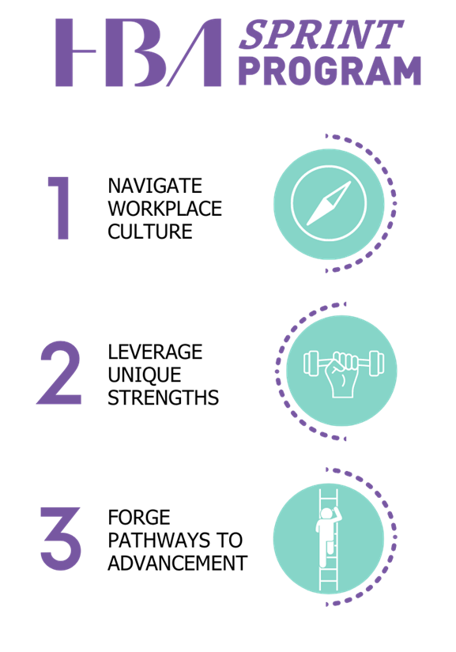

The HBA SPRINT Program is an accelerated leadership development program designed for high-potential leaders from underrepresented groups who have ambition for fast-tracking their careers.
Learn more about the HBA Sprint Program here.
Notes:
The HBA SPRINT Program is an exclusive, fast-track leadership initiative designed for ambitious women from underrepresented or underestimated groups who are ready to break barriers and elevate their careers. Unlike traditional programs, SPRINT directly addresses systemic challenges while equipping participants with tools to navigate and overcome them. Through targeted activities and access to influential networks, participants will gain unparalleled opportunities to amplify their strengths, refine their leadership skills, and fast-track their career advancement. Join a community of trailblazers committed to reshaping leadership and creating lasting change.

Slide 28


The HBA’s cohort-based leadership immersion program* accelerates career advancement through leadership development and strategic group initiatives that address organizational priorities within their company.
Learn about the HBA Ambassador Program here.
*Available to eligible HBA Corporate Partners (Trailblazer level and above)
Notes:
A signature offering for HBA Corporate Partners, the HBA’s global Ambassador Program is an immersive leadership experience. This cohort-based program, engaging 15-30 mid-level employees, accelerates career advancement through individual leadership development and strategic group initiatives that address organizational priorities. For the Ambassadors, the program boosts visibility, leadership growth, and career advancement. For companies, it enhances engagement, inclusion, and talent retention while driving strategic impact.

Slide 29
The HBA Think Tank
At the award-winning HBA Think Tank, we’re not just championing progress—we’re driving it.
The HBA Think Tank is a research-driven, collaborative hub dedicated to addressing systemic barriers and advancing opportunities for leaders in healthcare. As part of the HBA, the Think Tank equips companies with actionable insights, benchmarking tools, and innovative strategies to foster meaningful change. Through cutting-edge research, expert collaboration, and customized solutions, the HBA Think Tank empowers organizations to transform their workplaces, enhance health outcomes for women, and lead the way in creating a more representative healthcare ecosystem.
Learn more about the HBA Think Tank here.

Slide 30
Signature Events

Slide 31



HBA Woman of the Year Event 9 May 2025 in Chicago (and Remotely)
The HBA recognizes the work of leaders who have made significant contributions to the business of healthcare, are committed to continual innovation, and drive tangible business results in the workplace annually during the Woman of the Year celebration. This event attracts more than 2,000 attendees and garners significant visibility for the award recipients and their companies including Woman of the Year, Honorable Mentor, STAR (Strategic Transformation Achievement Recognition), Rising Stars, and Luminaries.
*The 2026 HBA Woman of the Year Event will be held in San Diego, California!

Slide 32
Rising Stars and Luminaries
Eligible Corporate Partner packages offer options to designate employee members as HBA Rising Stars and/or Luminaries. Award winners are honored at the annual HBA Woman of the Year celebration and benefit from year-long visibility.
Nominated by their Corporate Partner companies, Rising Stars represent various sectors across the healthcare industry. These leaders are not only exceptional contributors within their companies but also powerful advocates for health access globally.
Nominated by their Corporate Partner companies, Luminaries serve as a role model in their company, actively mentor and sponsor others, and exhibit dedication to the healthcare industry. These luminary leaders have more than 20 years of professional industry experience.

Slide 33



European Leadership Summit 12 - 13 June 2025 in Dublin, Ireland
The HBA European Leadership Summit (ELS) is an annual gathering dedicated to advancing the careers and impact of leaders in the healthcare and life sciences industry across Europe. Hosted in a different European city each year, this dynamic summit delivers world-class thought leadership, high-impact networking opportunities, and content that addresses the unique challenges and opportunities within the European healthcare ecosystem.
*The 2026 HBA European Leadership Summit will be held in Vienna, Austria!

Slide 34



HBA Annual Conference 29 September – 1 2025 October in Las Vegas, Nevada
The HBA's Annual Conference convenes healthcare industry professionals at all stages of their careers to build business connections for a sustainable leadership advantage, learn from thought leaders to broaden perspective, and share actionable insights. Globally renowned keynote speakers, cutting-edge workshops, and thoughtfully-curated networking opportunities offer robust opportunities to take advantage of HBA’s influential thought leadership community and engage with global members of our United Force for Change.

Slide 35
Building Better Business Connections (3BC)
The HBA’s Building Better Business Connections (3BC) event is an exclusive executive-only forum designed to accelerate leadership impact and business transformation.
In a focused, half-day experience, senior leaders engage in bold dialogue around workforce challenges, industry disruption, and innovative leadership—equipping them to drive meaningful change in their organizations and across the healthcare ecosystem.
Learn more about 3BC here.

Slide 36
Corporate Partnership

Slide 37
Lead the Way for Change
Partner with the HBA to accelerate advancement, elevate talent, and drive lasting business success.
Accelerate Leadership Develop high-potential talent—from rising stars to senior leaders—with proven programs that inspire innovation and results.
Fuel Growth, Drive Performance Access exclusive learning, mentoring, and leadership opportunities that boost engagement and business outcomes.
Celebrate Top Talent Enhance visibility and credibility through global recognition and thought leadership opportunities.
Join a Global Network Connect with purpose-driven leaders and innovators across the healthcare ecosystem.
Strengthen Your Brand Attract and retain talent with a visible, measurable investment in leadership excellence.
Partner with Purpose Align with a trusted organization advancing inclusive leadership and shaping the future of healthcare.

Slide 38
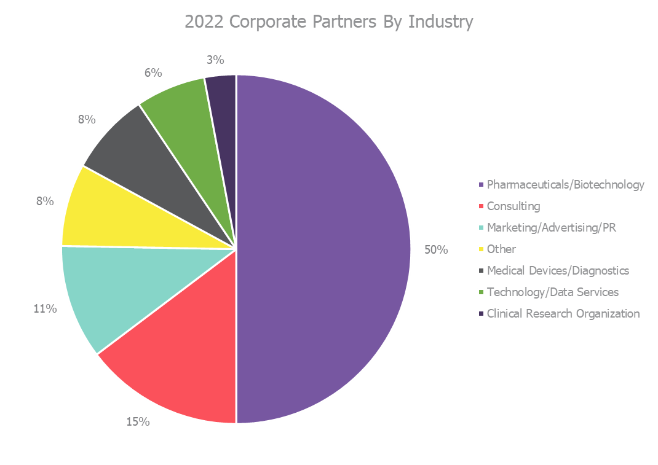
HBA Corporate Partners by Industry
As of 31 December 2024

Slide 39





























Current HBA Corporate Partners*
*Partial Listing

Slide 40
Corporate Partner Packages
The HBA's Corporate Partner offerings are thoughtfully designed to align with the priorities of healthcare and life sciences organizations of all sizes.
Explore the right path for your company by contacting: CorporatePartners@HBAnet.org.

Slide 41
Please contact HBA@HBAnet.org with questions

