Slide 1
HBA Marketing and Communications Forum
27 August 2025

Slide 2



Upcoming HBA Events and Key Dates
HBA Annual Conference (29 September – 1 October)
Member Leader Social Media Toolkit
Suggested social copy and graphics to aid promotional efforts (for HBA regions as well as individual members)
Standard Registration Pricing: Until 30 August
HBA Discounted Hotel Block: Closes 5 September

Slide 3
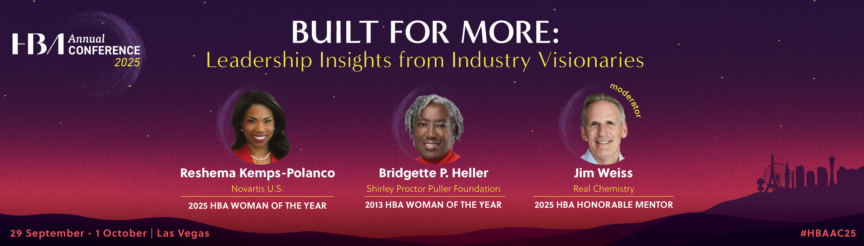
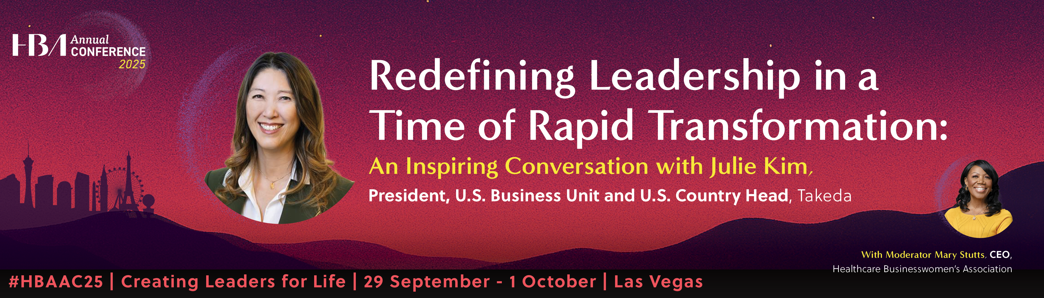

Upcoming HBA Events and Key Dates

Slide 4
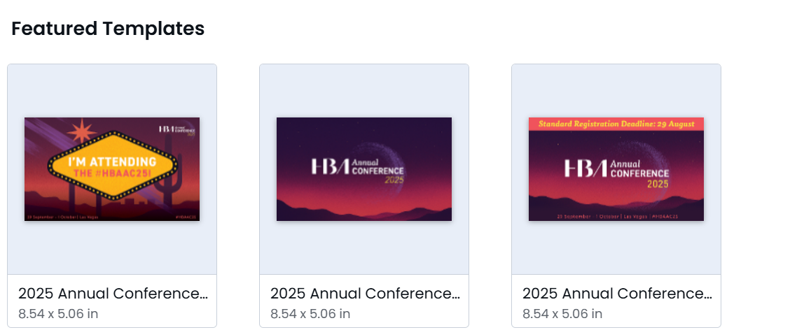
Upcoming HBA Events and Key Dates
#HBAAC25 Posts to Amplify
https://www.linkedin.com/feed/update/urn:li:activity:7366470073521184769
https://www.linkedin.com/feed/update/urn:li:activity:7364990055582474241
https://www.linkedin.com/feed/update/urn:li:activity:7364629331198844928
https://www.linkedin.com/feed/update/urn:li:activity:7359176666285285377

Slide 5

Upcoming HBA Events and Key Dates
2026 HBA Global Ascension Awards
The HBA’s expanded awards program honors a powerful legacy while adding a new Global Impact Award; 2026 event set for 24 April in San Diego, California
Article on HBA Website: https://hbanet.org/news/2025/08/26/healthcare-businesswomens-association-hba-opens-nominations-its-2026-global
HBA Social Post: https://www.linkedin.com/posts/healthcare-businesswomen-s-association_hbaimpact-activity-7366208222782828545-STdo?utm_source=share&utm_medium=member_desktop&rcm=ACoAABbk8KoBuhF9N-JEKr6x3cetDch51hbZpQk

Slide 6
External Affairs Team Updates
Marq Training (during an upcoming MarComms Forum)
Tentative Date: 29 October – Stay Tuned!

Slide 7

Q&A

