Slide 1
HBA Marketing and Communications Forum
29 October 2025

Slide 2
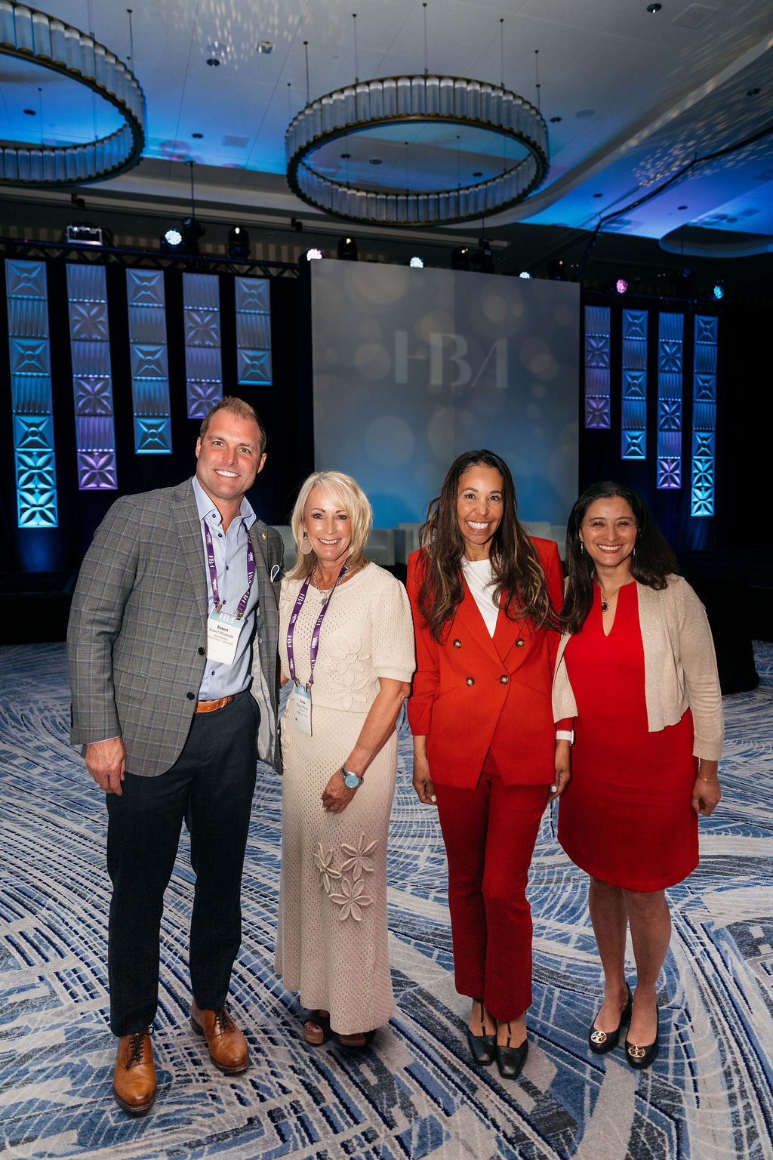
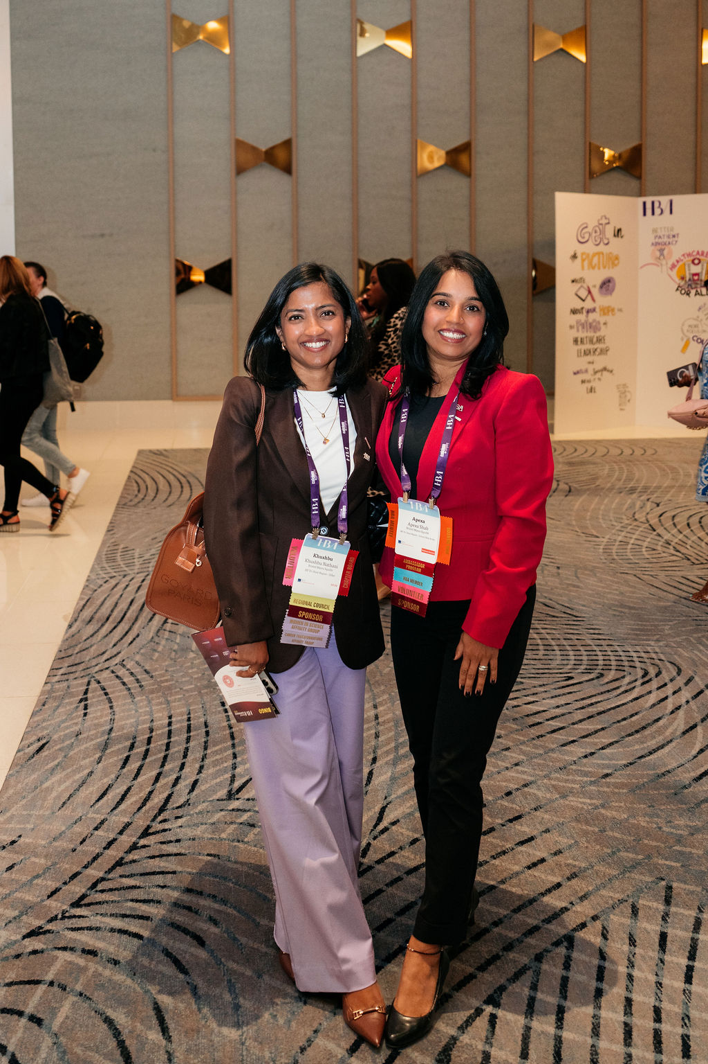
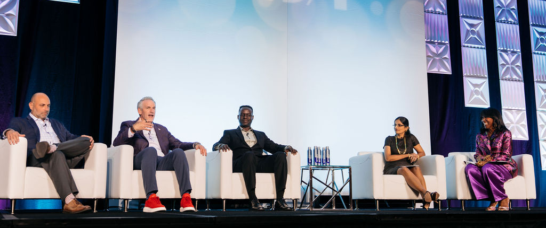
Today's Agenda
Review Upcoming HBA Events and Programs
Marq Overview with the Marq Team
Q&A with the Marq Team

Slide 3
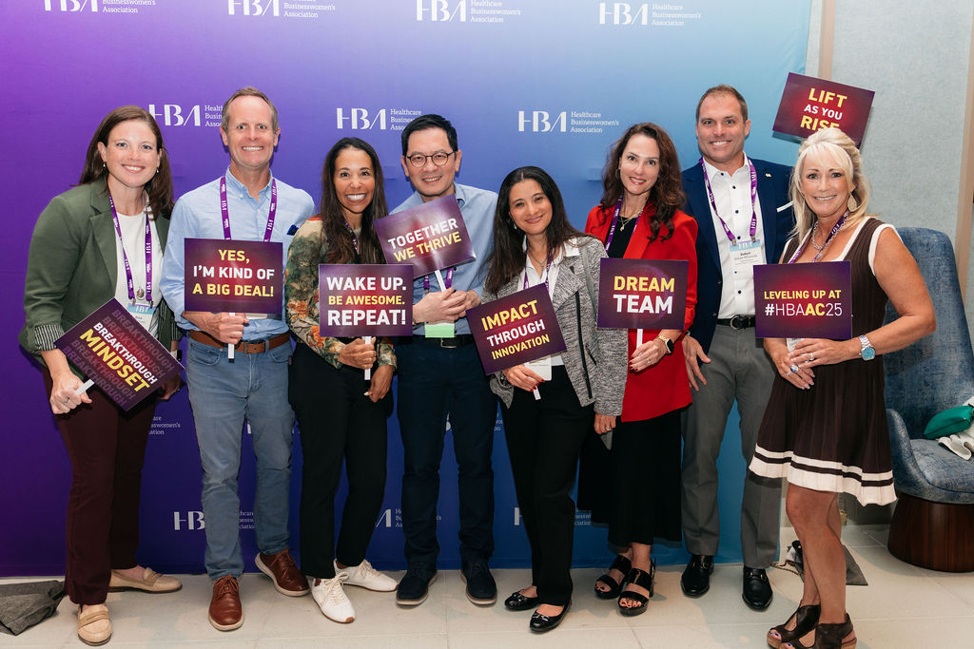
Upcoming HBA Events and Key Dates
2025 HBA Annual Business Meeting
Event Details:
Date: Thursday, 13 November 2025
Time: 11:00 AM - 12:00 PM EST
Format: Virtual
Register Now*
The Annual Business Meeting offers unique opportunities for HBA members to:
Celebrate the achievements that propelled us forward in 2025
Discover new initiatives shaping our goals for the year ahead
Hear the results of the 2026 Global Board of Directors election and meet the leaders guiding HBA’s next era
*This event is open to HBA members in good standing as of 1 October 2025

Slide 4
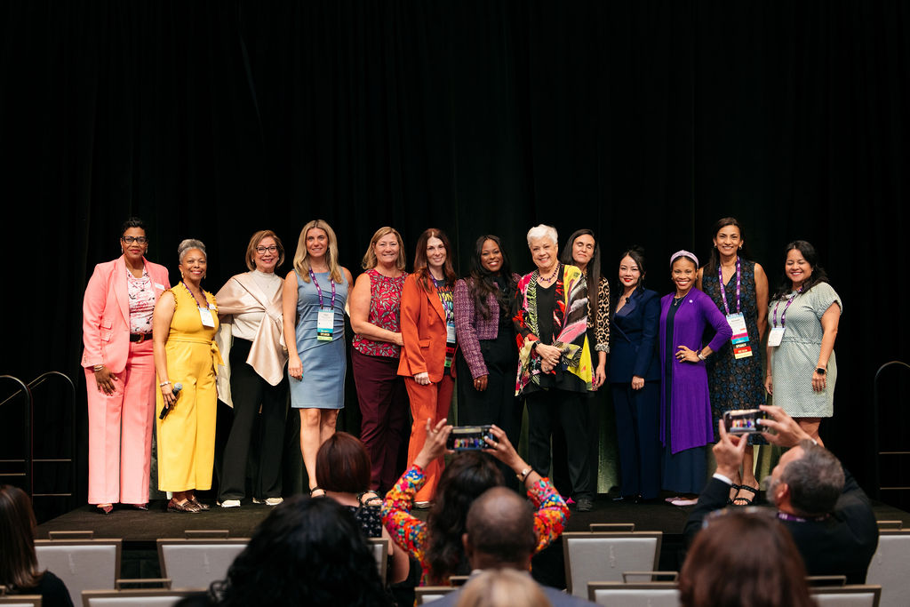
Upcoming HBA Events and Key Dates
2025 HBA Global Leadership Awards
Details
The Global Leadership Awards are peer-nominated and presented annually by HBA Central in recognition of exceptional contributions by HBA Member Leaders and members across the association.
These awards honor standout leadership, commitment, and meaningful impact, showcasing how recipients help advance HBA’s mission and strengthen its global professional community.
Submit your nominations by 31 October 2025
Submission guidelines and requirements here.

Slide 5
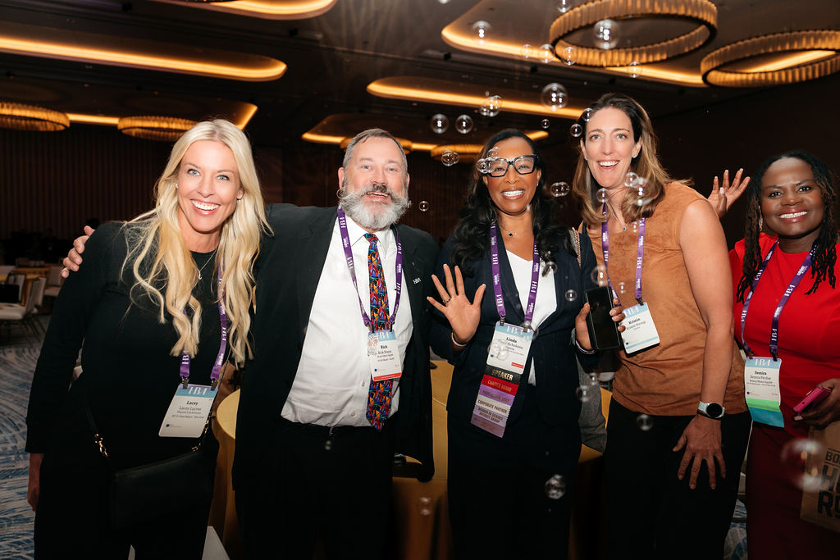
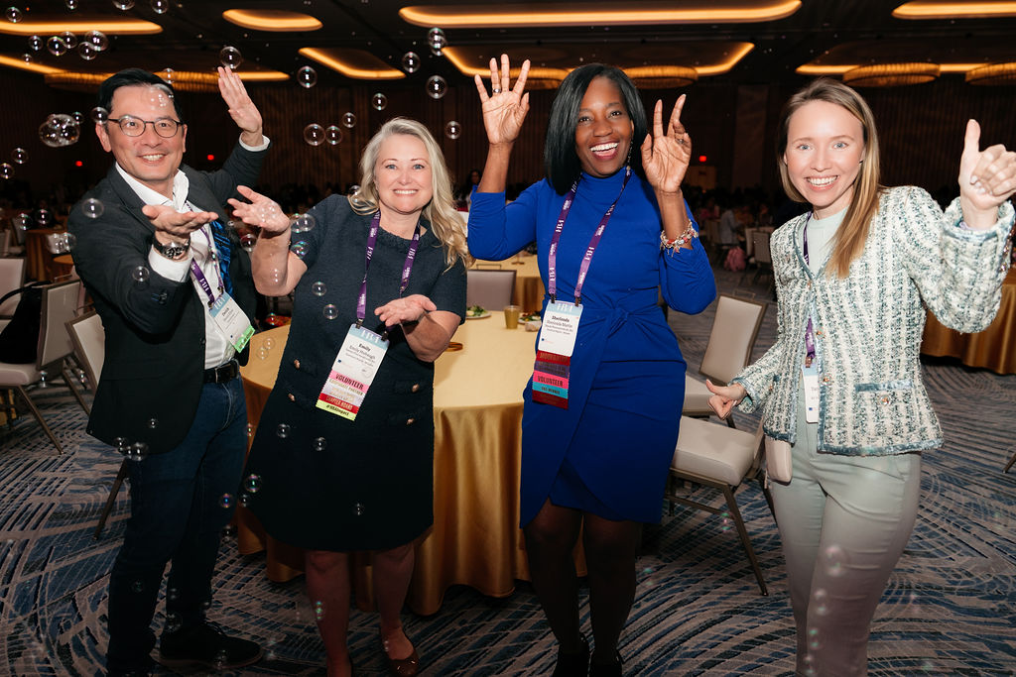
Upcoming HBA Events and Key Dates
2026 HBA Global Ascension Leadership Awards (GALA)
Event Details:
Date: 24 April 2026
Location: San Diego, California
HBA Award Dates and Deadlines:
2026 HBA Woman of the Year – Nominations close 30 October
2026 HBA Honorable Mentor – Nominations close 30 October
2026 HBA STAR – Nominations close 30 October
2026 HBA Rising Stars and Luminaries – Nominations open 12 November
*NEW* 2026 Global Impact Award – Nominations close 5 December

Slide 6
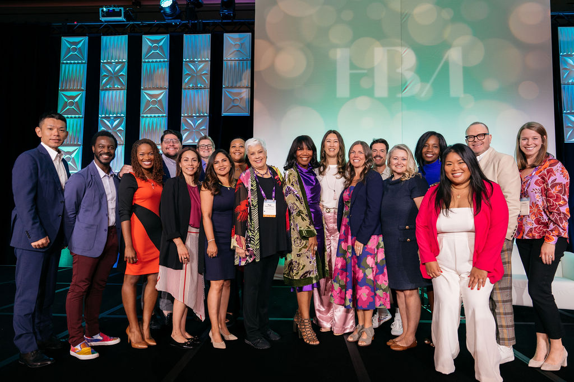
Upcoming HBA Events and Key Dates
2026 HBA Mentoring Program
Details:
Registration for the 2026 HBA Mentoring Program opens on 28 November 2025
The HBA Mentoring Program is new and improved for 2026!
Mentorship transforms careers, sparks growth, and builds the leaders of tomorrow.
Visit the HBA website to learn more about this program.

Slide 7
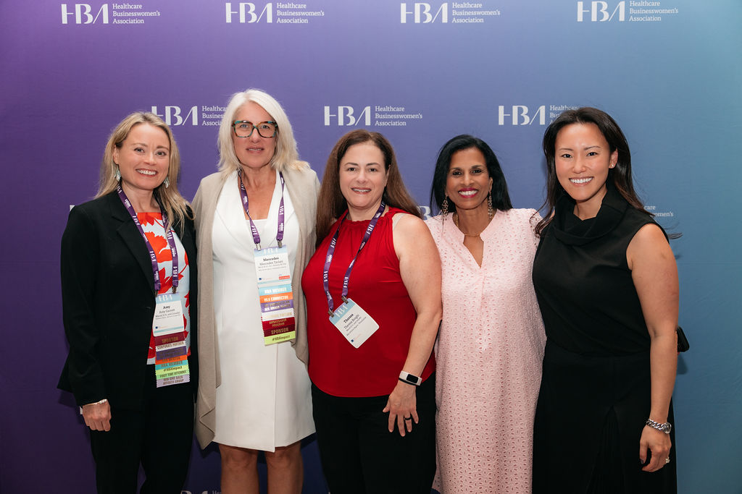

Upcoming HBA Events and Key Dates
Next Marketing and Communications Forum
Details:
Date: 9 December 2025
Time: 12:00 PM – 1:00 PM EST
Format: Virtual
Microsoft Teams Details:
Join the meeting now
Meeting ID: 291 286 342 453 5
Passcode: ve7oi3cA
Note: Email invitation with "Add to Calendar" feature to be sent in Early November

Slide 8

Marq Overview

Slide 9

Q&A

